Slide 1
WP6 Dissemination activity and collaborations
Francesco Cappelli (project manager)
Mid-Term Review Meeting
May 13, 2020
The Qombs Project is funded by the European Union’s Horizon 2020 research and innovation programme under grant agreement number 820419

Slide 2
WP6
Work Package 6 - Management, dissemination, collaboration and exploitation
Involved beneficiaries: CNR (leader), all in the Project
T6.1: Management (CNR, all partners; M1-M36).
The steering committee (work package leaders) met twice a year for project coordination.
Active and constructive cooperation among all the involved parties ensured a smooth progress of the project activity.
T6.2: Dissemination (CNR, all partners; M1-M36).
D6.1 Project Website
A dedicated project website has been realized: www.qombs-project.eu
It is divided into a public and a reserved area.
The reserved area is dedicated to the services useful for the project management.
2

Slide 3
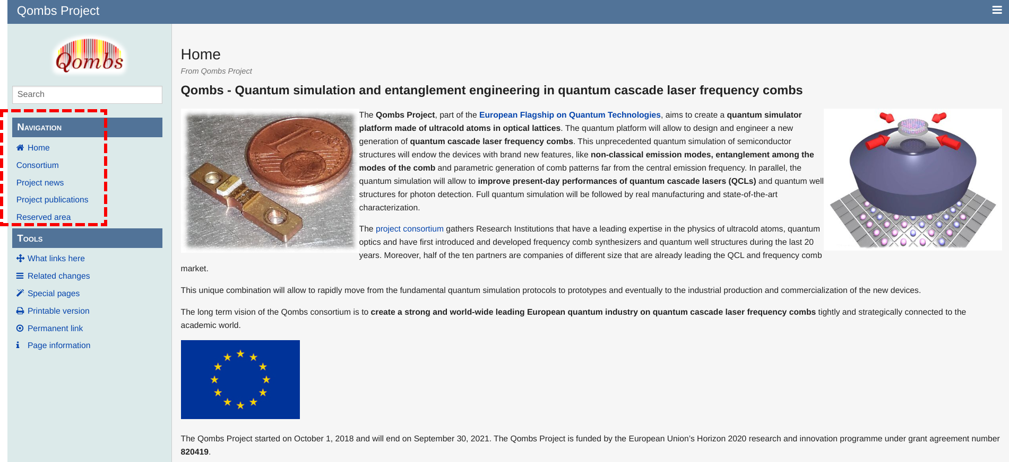
T6.2 Dissemination
www.qombs-project.eu
The public area contains:
the description of the project,
the presentations of the project partners,
the project presentations realized for a broad public
the list of publications related to the project.
3

Slide 4
T6.2 Dissemination
D6.2 Draft version of the Plan for the exploitation and dissemination of results (PEDR) – Delivered on time on September 30, 2019.
Main dissemination means:
publication on scientific journals
participation to conferences
organization of conferences
press releases
social network announcements
video clips
participation to fairs
presentations in high schools
4

Slide 5
T6.2 Dissemination
Publications list - 11 peer-reviewed papers published in high-impact international journals:
F. Cappelli, L. Consolino et al., “Retrieval of phase relation and emission profile of quantum cascade laser frequency combs,” Nature Photon. 13, 562 (2019), DOI:10.1038/s41566-019-0451-1, ArXiv:1905.00668
M. Franckié and J. Faist, “Bayesian Optimization of THz Quantum Cascade Lasers”, Phys. Rev. Appl. 13, 034025 (2020), DOI:10.1103/physrevapplied.13.034025, archive:https://www.research-collection.ethz.ch/handle/20.500.11850/406403
A. Bigioli et al., “Mixing properties of room temperature patch‐antenna receivers in a mid‐infrared (λ = 9 µm) heterodyne system,” Laser & Photon. Rev. 14, 1900207 (2020), DOI:10.1002/lpor.201900207, ArXiv:1907.05355
C. D'Errico et al., “Observation of quantum droplets in a heteronuclear bosonic mixture,” Phys. Rev. Research 1, 033155 (2019), DOI:10.1103/PhysRevResearch.1.033155, ArXiv:1908.00761
A. Burchianti et al., “Dual-species Bose-Einstein condensate of 41K and 87Rb in a hybrid trap,” Phys. Rev. A 98, 063616 (2018), DOI:10.1103/PhysRevA.98.063616, ArXiv:1810.08394v2
C. Jirauschek et al., “Optoelectronic Device Simulations Based on Macroscopic Maxwell–Bloch Equations,” Adv. Theory Simul. 2, 1900018 (2019), DOI:10.1002/adts.201900018
L. Consolino, F. Cappelli et al., “Phase analysis and full phase control of chip-scale infrared frequency combs,” Novel In-Plane Semiconductor Lasers XIX 11301, 1130119 (2020), DOI:10.1117/12.2545641, ArXiv:2004.03460
A. Burchianti et al., “A Dual-Species Bose-Einstein Condensate with Attractive Interspecies Interactions,” Condens. Matter 5, 21 (2020), DOI:10.3390/condmat5010021, ArXiv:2003.13362
I. Ricciardi et al., “Optical Frequency Combs in Quadratically Nonlinear Resonators,” Micromachines 11, 230 (2020), DOI:10.3390/mi11020230, ArXiv:2004.04714
J. Popp et al., “Monte Carlo Modeling of Terahertz Quantum Cascade Detectors,” accepted for 33rd URSI GASS 2020, ArXiv:2004.05891
L. Consolino et al., “Quantum Cascade Laser Based Hybrid Dual Comb Spectrometer,” Commun. Phys. 3, 69 (2020), DOI:10.1038/s42005-020-0344-0, ArXiv:https://arxiv.org/abs/2004.04061
5

Slide 6
T6.2 Dissemination
Attended international-level conferences (with presentations)
ECAMP
CLEO/EU
ICTON
ECSBM
HRMS
IRMMW-THz
SSDM
ITQW
Photonics West
SPIE Defense + Commercial Sensing
An international conference focusing on quantum cascade lasers technology is under organization by project partner ETHZ:
International Quantum Cascade Laser School & Workshop
(IQCLSW), Ascona (Switzerland), September 6-11, 2020
https://iqclsw.phys.ethz.ch
The Qombs Project results will be widely disseminated and discussed during the conference.
6

Slide 7
T6.2 Dissemination
Social networks:
Twitter post - November 20, 2018 on Thales Science Twitter account
https://twitter.com/ThalesScience/status/1064904485221343234
Youtube Video
https://www.youtube.com/watch?v=4D7Z_aufNOo&feature=youtu.be
Dissemination talk by the project coordinator Augusto Smerzi in occasion of a divulgative event named CineScienza in Florence (Italy), February 16, 2020 on paradoxes and opportunities of quantum mechanics:
http://www.caffescienza.it/programma-2019-2020/universi-paralleli
Press releases
https://www.cnr.it/it/intervento-presidente/8380/parte-programma-ue-da-1-miliardo-su-tecnologie-del-futuro
https://www.cnr.it/it/comunicato-stampa/8378/il-cnr-a-capo-di-un-gruppo-di-ricerca-europeo-per-lo-sviluppo-di-una-nuova-generazione-di-tecnologie-quantistiche
http://www.qtflagship.cnr.it/ > Qombs Project
https://www.corrierecomunicazioni.it/digital-economy/quantum-computing-leuropa-mette-sul-piatto-1-miliardo/
https://www.asitv.it/media/vod/v/5156
7

Slide 8
T6.2 Dissemination
CNR has organized with a high-school institute (Liceo Scientifico Leonardo da Vinci, Florence - Italy) a dissemination programme involving CNR-INO researchers and high-school students (January-February 2020).
At the end of the cycle of seminars the students should have visited CNR-INO/LENS facility in Florence for getting in touch with the ongoing experiments related to the Qombs project. This final part of the programme is currently suspended due to the COVID-19 outbreak.
Programme - a series of 6 seminars on:
Basic concepts of quantum mechanics and quantum optics
Quantum technologies
The job of the researcher
European funding agencies and project calls
A detailed explanation of the Qombs project structure and goals
8

Slide 9
T6.3 Joint Collaborative Tasks
T6.3: Joint Collaborative Tasks (CNR, all partners; M1-M36).
Collaboration between the Qombs Project and single projects within the Quantum Flagship.
Qombs-CiViQ collaboration: Study and implementation of a continuous-variables quantum communication protocol.
Qombs-QMiCS collaboration: Feasibility study of a low-loss free-space quantum communication system with long-wavelength radiation (infrared-microwaves).
These collaborations work in the direction of reaching the following milestone of the Strategic Research Agenda - Quantum Communication:
In 3 years, development and certification of QRNG and QKD devices and systems, addressing high-speed, high-TRL, low deployment costs, novel protocols and applications for network operation, as well as the development of systems and protocols for quantum repeaters, quantum memories and long distance communication.
9

Slide 10
T6.3 Joint Collaborative Tasks
T6.3: Joint Collaborative Tasks (CNR, all partners; M1-M36).
Participation in thematic collaboration groups within the Quantum Flagship.
The Qombs Project is involved in the following thematic collaboration groups:
Simulation platforms
Photonic platforms - Quantum light sources
Characterization of correlation and entanglement
Lasers stabilization (intensity) - lasers modulation, mixing, tunability
Free-space quantum signals
Quantum communication systems requirements
The participation ensures to the project all the possibly needed support and allows the project to more efficiently contribute to the general goals of the Quantum Flagship Initiative.
10

Slide 11
Reviewers’ and Project Officer’s questions
Reviewers’ and Project Officer’s questions
We tried to address some of them in these introductory presentations. Some others will be answered during the technical presentations that follows. The remaining ones will be answered during the last part of the meeting (Q&A session).
11

Slide 12
WP6
12

