Slide 1
WP5 - Industrialization and applications Companies innovation
Richard Maulini
Alpes Lasers S.A.
Mid-term Review meeting
May 13th 2020
The Qombs Project is funded by the European Union’s Horizon 2020 research and innovation programme under grant agreement number 820419

Slide 2
Overview of work package 5
Ongoing work
Companies innovations

Slide 3
Overview of WP5
16
Objectives:
Industrialize the QCL-comb, QCD and QWIP technologies developed in the project.
Develop new applications made possible by the technologies developed in the project.
Tasks:
T5.1: Packaging, characterization, and delivery of QCL combs to ASI (Alpes)
T5.2: Fabrication of QCL combs at a new wavelength (Alpes)
T5.3: Project devices integrated in new generation IRS spectrometer platform (IRS)
T5.4: Proof of performance measurement with new generation spectrometer (IRS)
T5.5: Production of market ready new generation ultra low noise current drivers (ppqS)
T5.6: Implementation of coherent detection schemes for LIDAR applications (TRT)
T5.7: Implementation of compact system based on QCL comb stabilized by WGMR (ASI)
T5.8: Project exploitation and long-term viability strategy (Alpes)
T5.9: Evaluation of the metrological DFG mid-infrared frequency comb (Menlo)

Slide 4
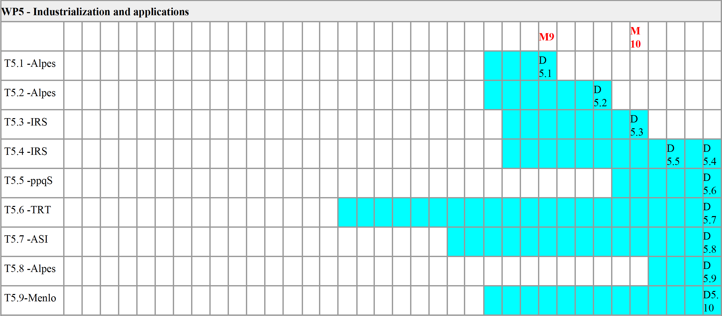
WP5 schedule - Gantt chart
Task 5.6 (TRT) ongoing
Task 5.2 (Alpes) preparatory work ongoing

Slide 5
Work in progress – Task 5.6
T5.6: Implementation of coherent detection schemes for LIDAR applications (TRT; M16-M36)
Focus on range finding and anemometry. The ultimate sensitivity addressable with QCL combs is targeted.
TRT is working on the architecture of the dual frequency comb based LIDAR.
Principle: comb #1 with rep. rate f sent to the target. Back-reflected signal coherently detected by interfering with comb #2 with rep.rate (f+∆f). The measured phase delay for each beat note is compared to a reference path to estimate the propagation time
Modeling and experimental works being conducted to demonstrate the feasibility using 1.55 µm lasers and fibered optics and measure the resolution and accuracy of this ranging method depending on the parameters of the setup.
Discussions with CNRS, Alpes, CNR and ppqSense ongoing to build a similar setup using mid-infrared QCL-combs.

Slide 6
Work in progress – Task 5.6
T5.6: Implementation of coherent detection schemes for LIDAR applications (TRT; M16-M36)
Reviewer question: For the (diurnal) LIDAR and communication applications, would it be interesting to tune the QCL emission on a Fraunhofer line of the Sun?
The question from the reviewer is indeed important for direct detection schemes, especially in the visible and near-infrared spectral ranges.
In the mid-infrared spectral range where QCL emit (4-12 µm), the emissivity of the targeted scene outreaches the solar photons.
In the LIDAR setup being implemented in QOMBS, the detection is coherent and the detected signal is thus filtered.
In the mid-infrared, it is important to work in the atmospheric windows at 3-5 µm or 8-12 µm in order to avoid molecular absorption.
Most molecules present in the atmosphere that could “shield” from solar radiation are also present at ground level and would reduce the laser signal.

Slide 7
Work in progress – Task 5.2
T5.2: Fabrication of QCL combs at a new wavelength (Alpes; M24-M30)
Fabrication of QCL combs according to IRS’s requirements to monitor reaction kinetics of a biological molecule
Based on the results of WP3, Alpes developed high-performance QCL combs at a wavelength of 6 µm (1650 cm⁻¹) with a spectral width of up to 70 cm⁻¹.
This wavelength is important for the spectroscopy of proteins as it corresponds to the amide I band.
The lasers were tested in a dual-comb setup by IRS.
Alpes is now preparing and packaging the new devices for IRS.

Slide 8
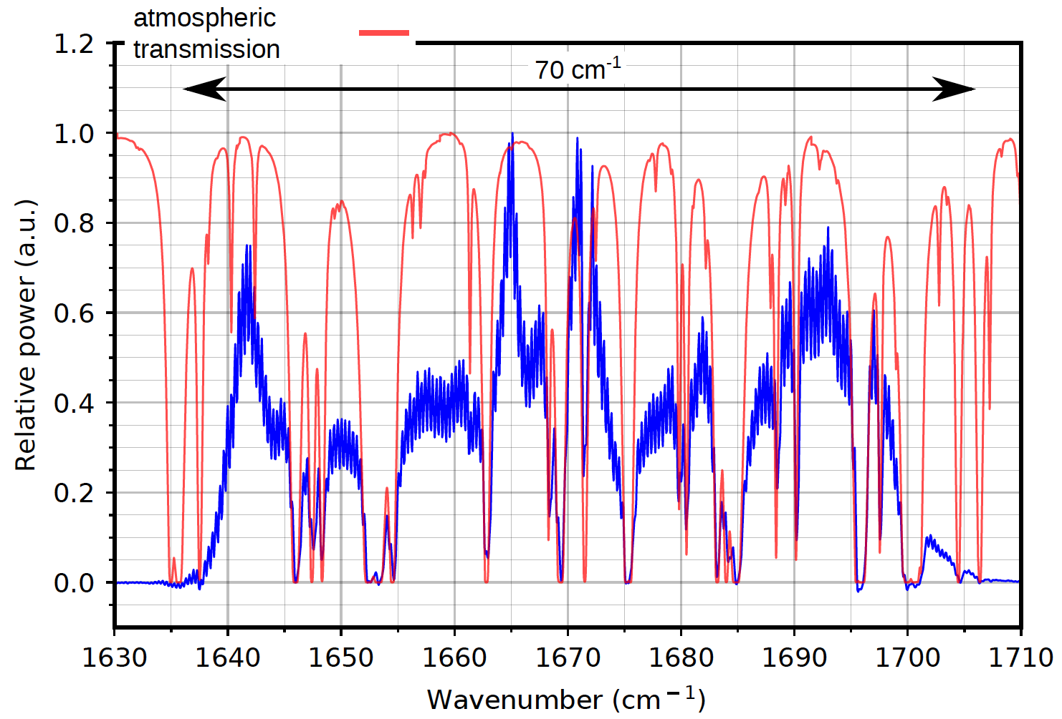
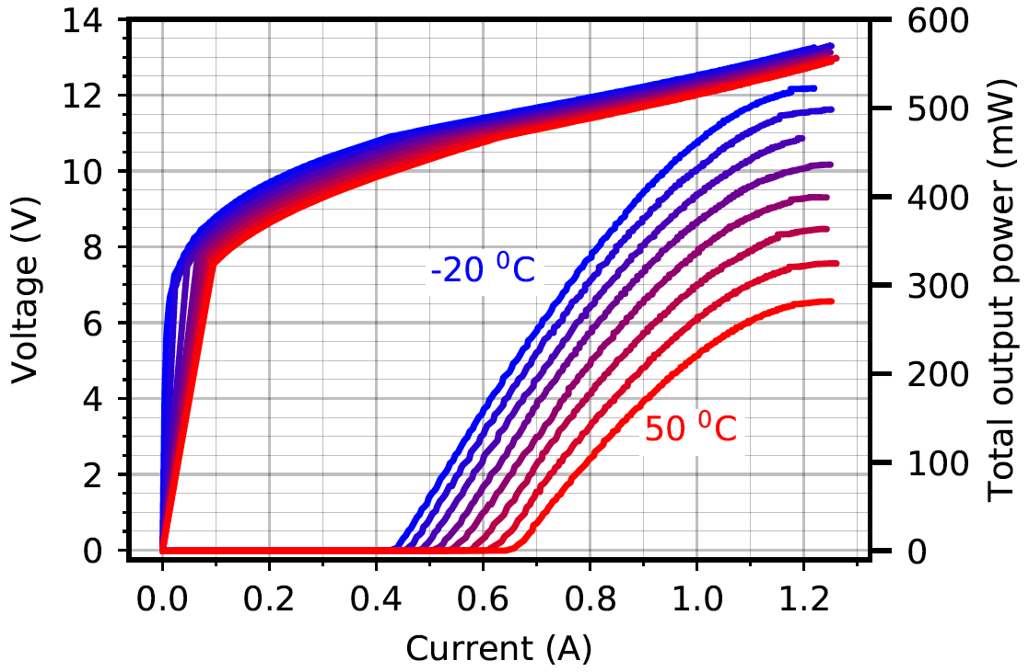
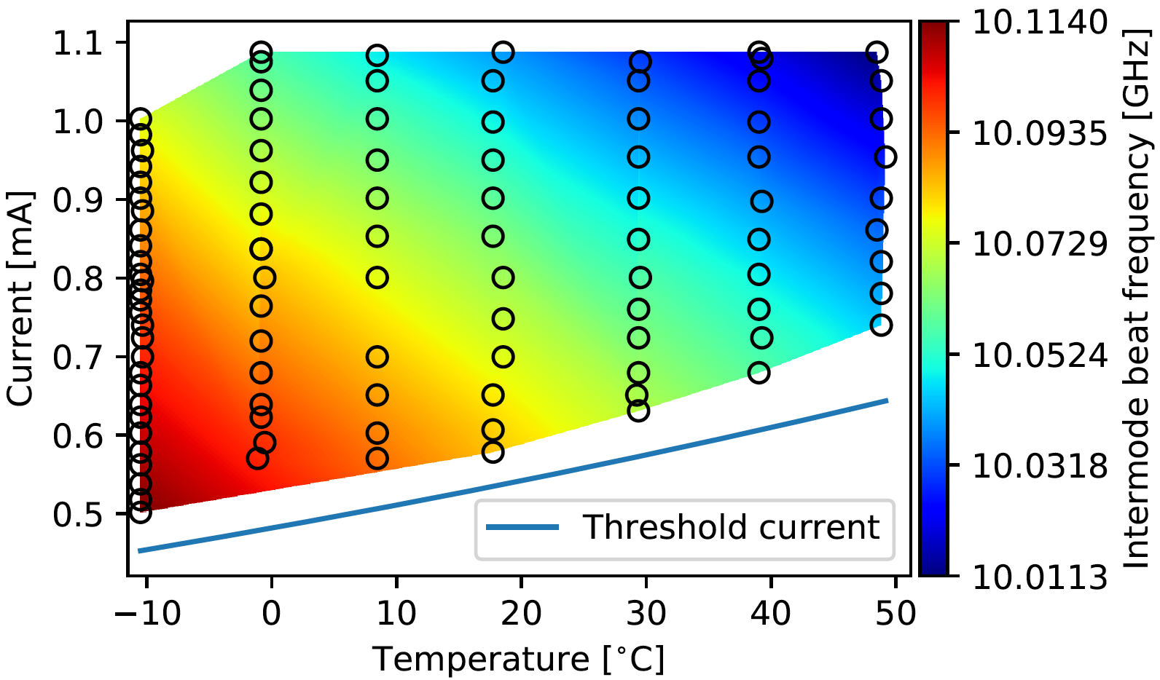
Work in progress – Task 5.2
High performance QCL combs in the amid I band of proteins
Comb operation up to 50ºC
400 mW output power at 20ºC
Mode spacing: 10 GHz = 0.33 cm-1
Average power per mode: ~2 mW

Slide 9
Company innovations
The Project consortium is composed of 5 research institutes and 5 companies, including 4 SMEs
The Qombs project is committed in bringing the following important technological results:
Compact and powerful mid-infrared optical frequency combs
Compact ultra-low-noise current drivers
Integrated compact setup for dual-comb spectroscopy,
Mid-infrared lidars and low-scattering free space communication systems,
Metrological references for high-resolution molecular spectroscopy.
All these technologies will have a strong impact on everyday life.

Slide 10
Company innovations
Reviewer question: Which ones of the following were realized up to now (and how):
Enhance innovation capacity
Create new markets opportunities
Strengthen competitiveness and growth of companies
Address issues related to climate change or the environment
Address industrial and/or societal needs at regional level or bring other important benefits for society?
Give information on the relevant innovation activities carried out (prototypes, testing activities, standards, clinical trials) and/or new product, service, reference materials, process or method (to be) launched to the market.
The newly developed QCL comb wavelengths strengthen Alpes’ competitiveness on the QCL market and IRsweep’s competitiveness on the fast mid-IR spectroscopy market. These enable new applications and thus new market opportunities.
Menlo has developed a working prototype of DFG mid-infrared frequency comb. This prototype will result in a commercial product after project end.

