Slide 1
Q&A
Augusto Smerzi (coordinator)
Francesco Cappelli (project manager)
Mid-Term Review Meeting
May 13, 2020
The Qombs Project is funded by the European Union’s Horizon 2020 research and innovation programme under grant agreement number 820419

Slide 2
Reviewers’ and Project Officer’s questions
Here follows the answers the Reviewers’ and the Project Officer’s questions.
Please consider that some of them have already been adressed in the introductory presentation and some of them will be / have been answered in the technical presentations.
2

Slide 3
Performed work and main results
Objective | Achievement | Still to realize
Design and fabrication of new QCL devices | Numerically-optimized devices realized | Quantum-simulation-optimized devices realized
Realization of a quantum simulator of QCLs transport | Large spacing 1D optical lattice to mimic QCL potential | Loading the atoms, simulating transport
Demonstration of nonclassical features in QCL emission | Implementation of a mid-infrared balanced detector, characterization of detectors, discovery of optimal laser operating condition for investigation | Demonstration of squeezed/entangled emission, test of several devices
Applications (sensing, communication, range find, anemometry) | New devices to be used for applications fabricated, dual-comb spectrometer tested | Development of the applications
3

Slide 4
Collaborations between the teams in the project
Consortium members, roles and collaborations
Consiglio Nazionale delle Ricerche (CNR – research institute – coordinator):
Development of quantum simulator
Development of theoretical model for QCL quantum comb emission
Characterization of QCL emission
Eidgenössische Technische Hochschule Zürich (ETHZ – research institute/university):
Design and fabrication of QCLs (lasers) and QCDs (detectors)
Technische Universität München (TUM – university):
Development of theoretical models and numerical simulations for QCLs and QCDs design
Centre National de la Recherche Scientifique (CNRS – research institute):
Design, fabrication and characterization of quantum cascade detectors (QCDs)
Alpes Lasers SA (Alpes – company):
QCLs fabrication and industrialization
Collaboration among ETH, TUM, CNRS and Alpes for the design and the fabrication of new QCL devices and new QCDs (detectors).
Collaboration among CNR, ETH and TUM for transferring quantum simulation hints to new QCL devices.
4

Slide 5
Collaborations between the teams in the project
Agenzia Spaziale Italiana (ASI – agency):
Support to QCLs characterization
ppqSense SRL (ppqS – company):
Development and realization of ultra-low-noise current drivers
IRsweep GmbH (IRS – company):
QCLs testing and development of dual-comb spectrometers
Menlo Systems GmbH (Menlo – company):
Realization of a mid-infrared DFG frequency comb for QCLs characterization
Thales Research & Technology (TRT – company):
Development of range finding and anemometry instrumentation based on QCLs
Collaboration among CNR, ETH, Menlo, CNRS, ASI and IRsweep for the characterization of new QCLs and QCDs.
Collaboration among Alpes, IRsweep, ppqSense and Thales for developing applications.
We remark that the Qombs Project is based on the collaboration among research institutes and companies, mixing research expertise in quantum technologies and industrial know-how in prototypes realization.
5

Slide 6
Questions and answers
Future plans. What are the most challenging aspects? Do you foresee any major problems? Is there a back up plan?
We are currently investigating the nonclassicality in QCLs frequency comb emission. Since the multifrequency system is quite complex (many modes) this is a non straightforward task. The backup plan is to realize and study simplified systems such as QCLs designed to emit only three modes (canonical degenerate FWM) or even single-frequency emitting QCLs.
Do you propose any major changes with respect to the initial plan?
The overall activity has progressed smoothly during the first project period. Regarding the second project period, due to the COVID-19 outbreak, significant delays are expected in the activities requiring facilities and human-operated machines. The consortium is now focusing on modeling and designing activities and will implement all the possible actions for minimizing the impact.
Please comment on new foreseen risks, risk encountered in the first period, contingency plans adopted, and the related evolution of the project.
This question is addressed in the technical presentations.
6

Slide 7
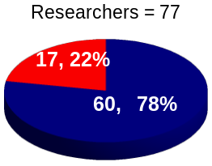
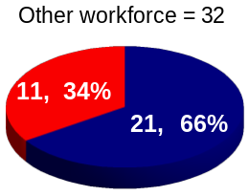
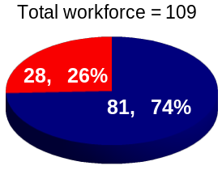
Questions and answers
With regard to IP, did the research and technological activity of the First Period generate any patents up to know?
Not for the moment.
Several open source software program are mentioned in the DoA/PTR; I did not find any description instead of data handling and archiving protocols.
To date all the collected data are stored on servers present by the consortium members, in the cases required by the project activity they are shared among project partners. All the data related to publications are made and will be made available upon reasonable request via the most appropriate platforms (Open Science Framework, Figshare, etc.).
Where you be able to reach gender balance at all levels of personnel assigned to the action?
Females, Males
To date, did the Qombs Project generate follow-up activities/projects?
Not for the moment.
7

Slide 8
Questions and answers
How is the Qombs Project contributing to the Flagship’s objectives:
To consolidate and expand European scientific leadership and excellence in quantum research, including education and training for developing the relevant know-how and skills.
To make Europe a dynamic and attractive region for innovative research, business and investments in quantum technologies, thus accelerating their development and take-up by the market.
The Qombs Project is carring on a high-level research activity in the field of quantum technology. Half of the consortium members are research institutes / universities width an intense teaching activity both at master and PhD level. Several PhD students are involved in the project activities.
The other half of the consortium members are companies strongly connected with research and highly motivated in bringing the newly-develped quantum technologies to the marlet.
8

Slide 9
end
End
9

