Slide 1
WP4
Characterization
WP leader:
Alessandro Zavatta
Speaker:
Natalia Bruno
Mid-term Review meeting
May 13th 2020
The Qombs Project is funded by the European Union’s Horizon 2020 research and innovation programme under grant agreement number 820419

Slide 2
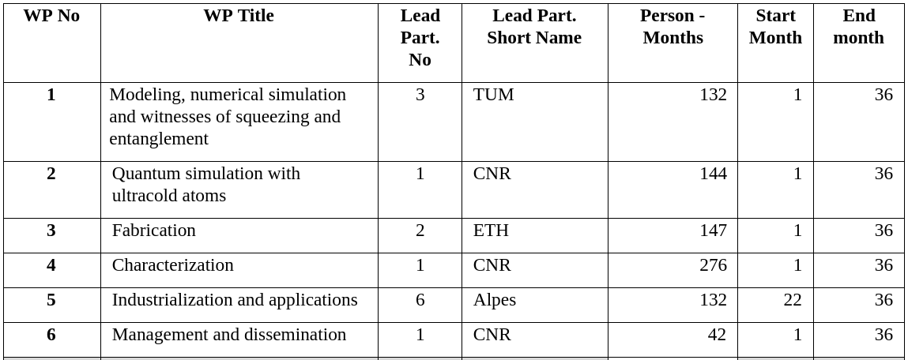
Qombs – WP4
Main target: characterization methodologies for QCL-combs

Slide 3
Outline
TASKS | DELIVERABLES
T4.1: Characterization of QCL-combs (CNR; M1-M36) T4.1.1: Characterization of available QCL-combs (M1-M10) T4.1.2: Characterization of new-generation QCL-combs (M6-M36) T4.1.3: Squeezing detection in QCL-combs using new-generation QCDs (M11-M36) | D4.1 M10 D4.3 M12, D4.4 M30 D4.6 M24
T4.2: Development and test of a metrological difference-frequency-generated mid-infrared frequency comb (MENLO; M1-M24) | D4.2 M8
T4.3: QCDs and QWIPs characterization (CNRS; M12-M36) | D4.5 M30
T4.4: Characterization of QCL-comb sensing systems (IRS; M1-M24) T4.4.1: Characterization of state-of-the-art QCL-comb sensing systems (M1-06) T4.4.2: Characterization of quantum-simulation-optimized lasers in spectroscopy system (M7-M24) T4.4.3: Dual-comb spectroscopy with quantum detectors (M9-M24) | D4.10 M6 D4.11 M24 D4.7 M24
T4.5: Development and characterization of ultra-low noise current drivers (PPQS, CNR, ASI, CNRS, ALPES, TRT and IRS; M1-M30) T4.5.1: Fabrication of currently-available current drivers for project partners (M1-M6) T4.5.2: Development and testing of ultra-low noise current drivers (M7-M30) | D4.8 M6 D4.9 M30
T4.6: Characterization of (new-generation) QCL-combs using Ultra High-Q Whispering Gallery mode Resonators (ASI, CNR; M4-M30) | D4.12 M27
MILESTONES: MS7-M26, MS8-M30, CNR

Slide 4
T4.1: Characterization of QCL-combs
TASKS | DELIVERABLES
T4.1: Characterization of QCL-combs (CNR; M1-M36) T4.1.1: Characterization of available QCL-combs (M1-M10) T4.1.2: Characterization of new-generation QCL-combs (M6-M36) T4.1.3: Squeezing detection in QCL-combs using new-generation QCDs (M11-M36) | D4.1 M10 D4.3 M12, D4.4 M30 D4.6 M24
T4.2: Development and test of a metrological difference-frequency-generated mid-infrared frequency comb (MENLO; M1-M24) | D4.2 M8
T4.3: QCDs and QWIPs characterization (CNRS; M12-M36) | D4.5 M30
T4.4: Characterization of QCL-comb sensing systems (IRS; M1-M24) T4.4.1: Characterization of state-of-the-art QCL-comb sensing systems (M1-06) T4.4.2: Characterization of quantum-simulation-optimized lasers in spectroscopy system (M7-M24) T4.4.3: Dual-comb spectroscopy with quantum detectors (M9-M24) | D4.10 M6 D4.11 M24 D4.7 M24
T4.5: Development and characterization of ultra-low noise current drivers (PPQS, CNR, ASI, CNRS, ALPES, TRT and IRS; M1-M30) T4.5.1: Fabrication of currently-available current drivers for project partners (M1-M6) T4.5.2: Development and testing of ultra-low noise current drivers (M7-M30) | D4.8 M6 D4.9 M30
T4.6: Characterization of (new-generation) QCL-combs using Ultra High-Q Whispering Gallery mode Resonators (ASI, CNR; M4-M30) | D4.12 M27
MILESTONES: MS7-M26, MS8-M30, CNR

Slide 5
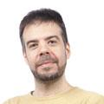
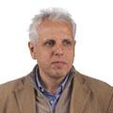
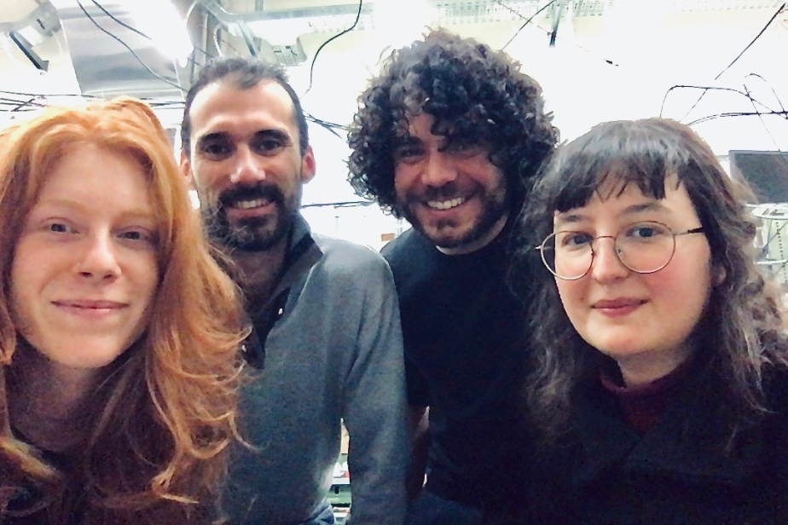
T4.1: Characterization of QCL-combs
TASKS | DELIVERABLES
T4.1: Characterization of QCL-combs (CNR; M1-M36) T4.1.1: Characterization of available QCL-combs (M1-M10) T4.1.2: Characterization of new-generation QCL-combs (M6-M36) T4.1.3: Squeezing detection in QCL-combs using new-generation QCDs (M11-M36) | D4.1 M10 D4.3 M12, D4.4 M30 D4.6 M24
Simone
Borri
Paolo De Natale
Alessandro Zavatta
Nicola
Biagi
Theoretical support:
Robin Corgier
Luca Pezzé
Augusto Smerzi
Tecla Gabbrielli
Francesco Cappelli
Nicola
Corrias
Natalia
Bruno

Slide 6
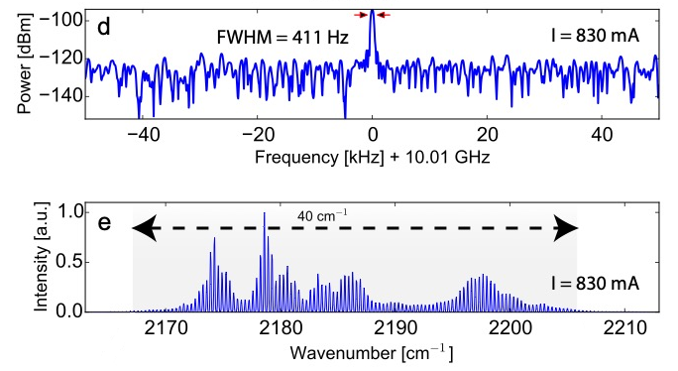
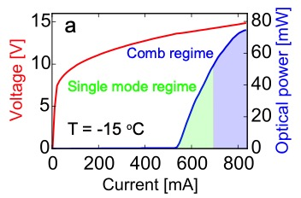
T4.1.1: available QCL-combs
TASKS | DELIVERABLES
T4.1: Characterization of QCL-combs (CNR; M1-M36) T4.1.1: Characterization of available QCL-combs (M1-M10) T4.1.2: Characterization of new-generation QCL-combs (M6-M36) T4.1.3: Squeezing detection in QCL-combs using new-generation QCDs (M11-M36) | D4.1 M10 D4.3 M12, D4.4 M30 D4.6 M24
First QCL-comb characterization
Dual-waveguide QCL-comb @ 4.5 μm from ETH
EV1527D
PartE
C1622 LO4 (IV)
L = 4.5 mm, 4.5 μm
fs = 10 GHz, 7 kΩ resistance
Bidaux, Y., Kapsalidis, F., Jouy, P., Beck, M., Faist, J., Laser & Photonics Reviews 2018, 12, 1700323

Slide 7
T4.1: Deliverables
TASKS | DELIVERABLES
T4.1: Characterization of QCL-combs (CNR; M1-M36) T4.1.1: Characterization of available QCL-combs (M1-M10) T4.1.2: Characterization of new-generation QCL-combs (M6-M36) T4.1.3: Squeezing detection in QCL-combs using new-generation QCDs (M11-M36) | D4.1 M10 D4.3 M12, D4.4 M30 D4.6 M24
D4.1: First QCL-comb devices characterized and delivered to TRT and IRS (CNR - M10)
Delivered
benchmarks for future experiments

Slide 8
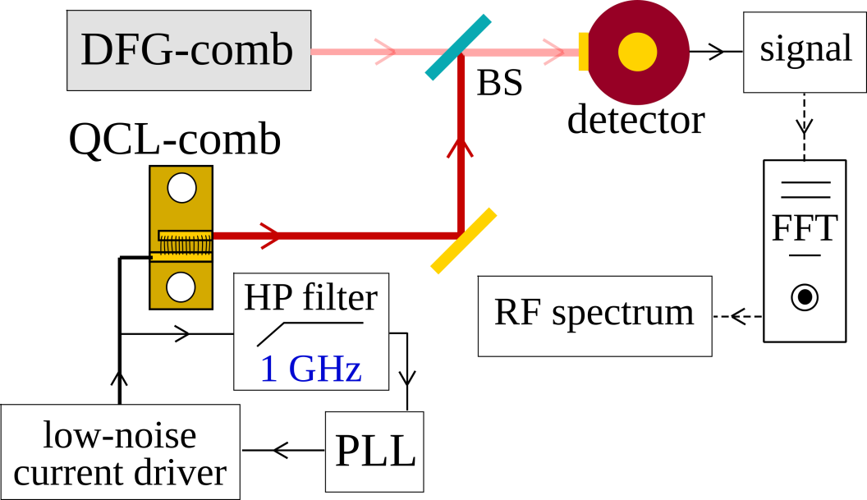
T4.1.2: new QCL-combs
TASKS | DELIVERABLES
T4.1: Characterization of QCL-combs (CNR; M1-M36) T4.1.1: Characterization of available QCL-combs (M1-M10) T4.1.2: Characterization of new-generation QCL-combs (M6-M36) T4.1.3: Squeezing detection in QCL-combs using new-generation QCDs (M11-M36) | D4.1 M10 D4.3 M12, D4.4 M30 D4.6 M24
multi-heterodyne beat note detection

Slide 9
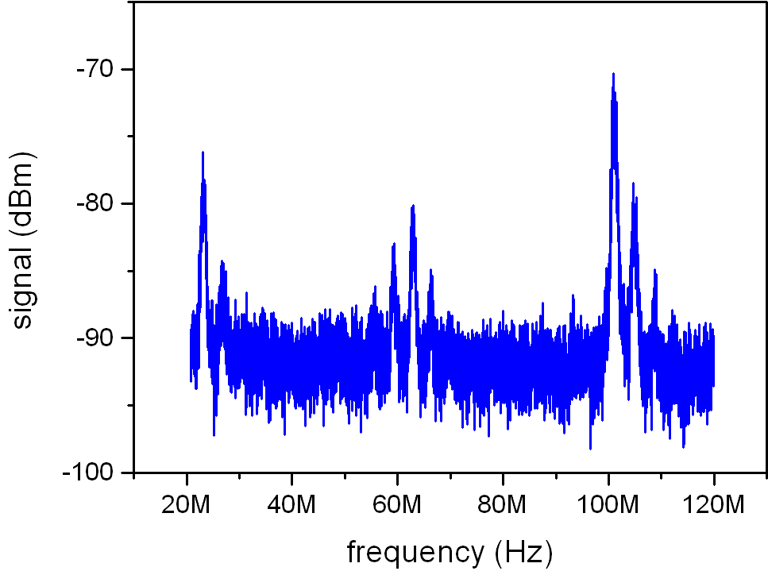
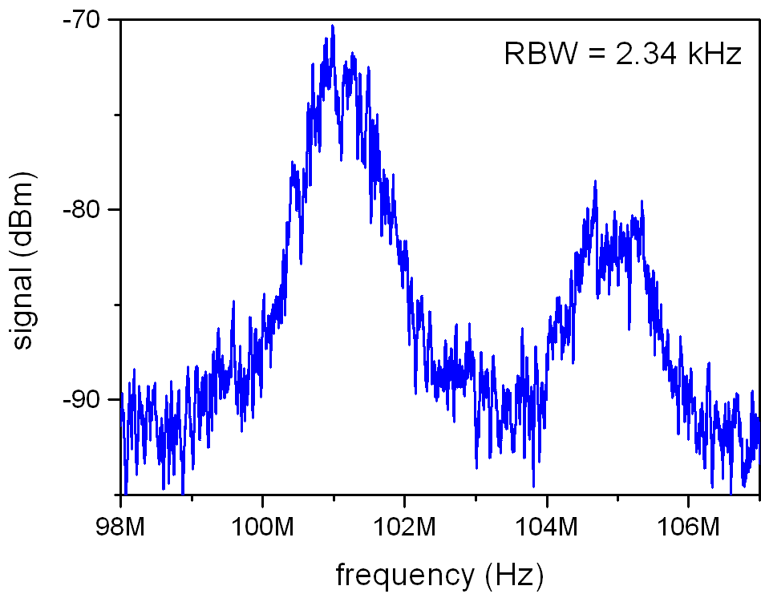
T4.1.2: new QCL-combs
T4.1.2: Characterization of new-generation QCL-combs (M6-M36)
- FSR QCL =10 GHz
- FSR Menlo laser = 250 MHz
FWHM ~ 1 MHz
compatible with free-running
QCL linewidth

Slide 10
T4.1: Deliverables
TASKS | DELIVERABLES
T4.1: Characterization of QCL-combs (CNR; M1-M36) T4.1.1: Characterization of available QCL-combs (M1-M10) T4.1.2: Characterization of new-generation QCL-combs (M6-M36) T4.1.3: Squeezing detection in QCL-combs using new-generation QCDs (M11-M36) | D4.1 M10 D4.3 M12 D4.4 M30 D4.6 M24
D4.1: First QCL-comb devices characterized and delivered to TRT and IRS (CNR - M10)
Delivered
D4.3: New-generation QCL-comb characterized and delivered to TRT and IRS (CNR – M12, M30)
Delivered
D4.4: New-generationQCL-combs (second generation active region design - D1.3)characterized anddelivered to TRT andIRS. (CNR- M30)
Work in
progress

Slide 11
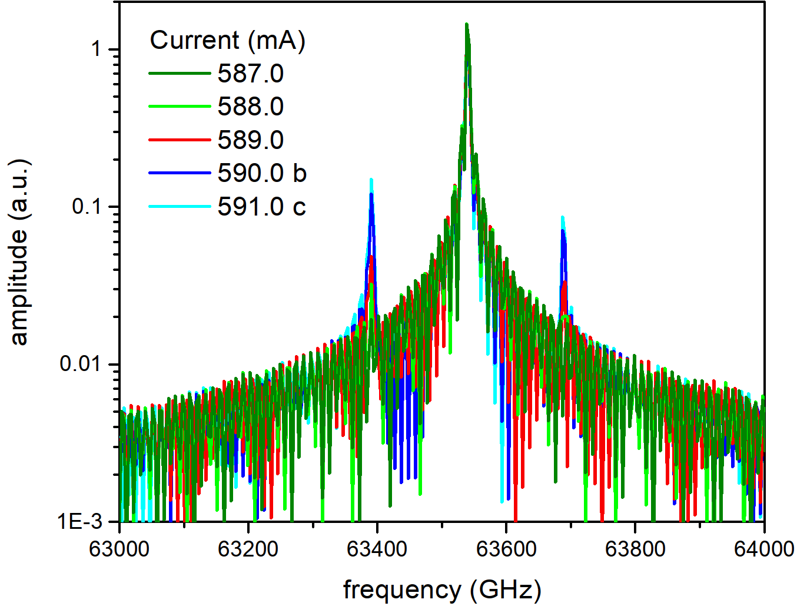
T4.1.3: search for squeezing
TASKS | DELIVERABLES
T4.1: Characterization of QCL-combs (CNR; M1-M36) T4.1.1: Characterization of available QCL-combs (M1-M10) T4.1.2: Characterization of new-generation QCL-combs (M6-M36) T4.1.3: Squeezing detection in QCL-combs using new-generation QCDs (M11-M36) | D4.1 M10 D4.3 M12, D4.4 M30 D4.6 M24
QCL-comb EV1 299A-107
@ 4.7 μm from
Four Wave Mixing?

Slide 12
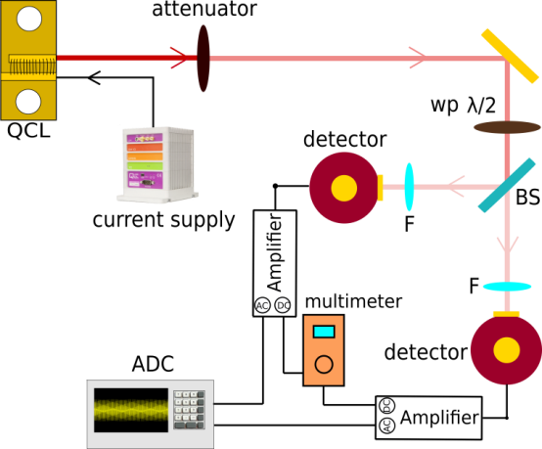
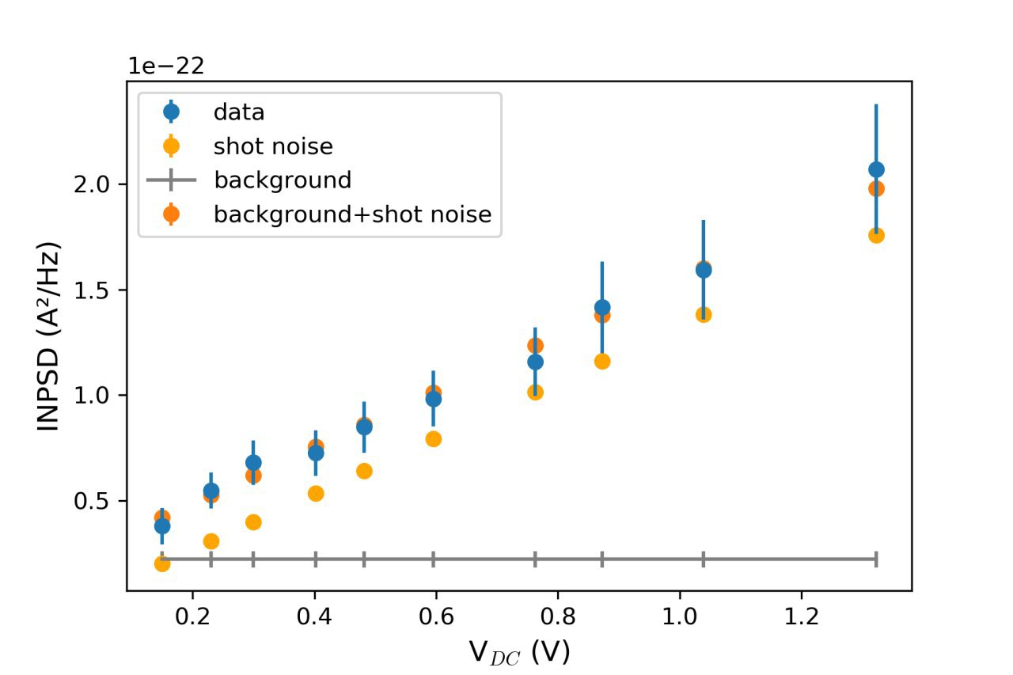
T4.1.3: search for squeezing
T4.1.3: Squeezing detection in QCL-combs using new-generation QCDs (M11-M36)
Grating
Is it possible to measure the shot noise with our detectors?
We used the QCL in single mode operation to characterize the balanced detection scheme.

Slide 13
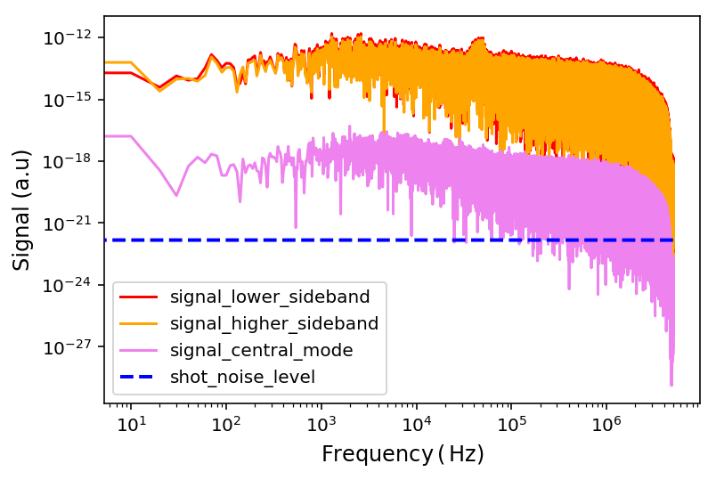
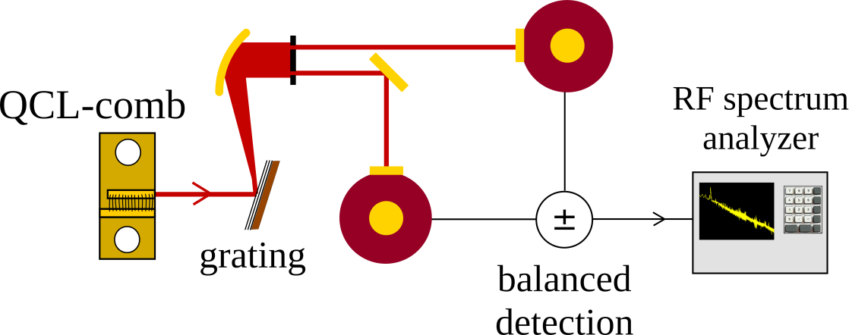
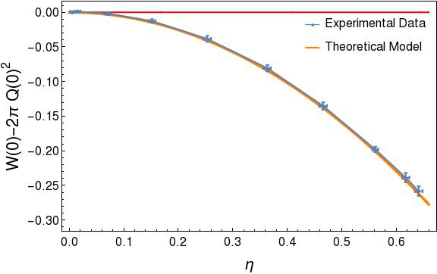
T4.1.3: search for squeezing
T4.1.3: Squeezing detection in QCL-combs using new-generation QCDs (M11-M36)
1) Characterization of two-mode squeezing with a balanced detector
Normalized signal
2) Analysis of cross-correlation vs auto-correlation of the sidebands
3) Non-classicality certification test on a single-mode quantum system
13

Slide 14
WP4 Bottlenecks & lessons
TASK | Problem | Solution
T4.1 | Non-classicality of QCL combs with multimode emission could be non-trivial to detect Correlations shared among many modes are non-trivial to detect; Gain and loss could degrade quantum correlations. | CNR-INO asked ETH for new devices: Minimum cavity losses and narrowband gain (e.g. with low doping) Optimized χ⁽³⁾ / χ⁽¹⁾ nonlinearity; Number of modes as low as possible (3); larger mode spacing for simplifying the study of correlations.
T4.1 | Current detectors (InSb IR) are limiting the detection of squeezing for low saturation intensity; high background noise; low bandwidth. | testing new detectors (MCT, received in March 2020); waiting for QCD developed by CNRS.

Slide 15
T4.1: Deliverables
TASKS | DELIVERABLES
T4.1: Characterization of QCL-combs (CNR; M1-M36) T4.1.1: Characterization of available QCL-combs (M1-M10) T4.1.2: Characterization of new-generation QCL-combs (M6-M36) T4.1.3: Squeezing detection in QCL-combs using new-generation QCDs (M11-M36) | D4.1 M10 D4.3 M12, D4.4 M30 D4.6 M24
D4.1: First QCL-comb devices characterized and delivered to TRT and IRS (CNR - M10)
Delivered
D4.3: New-generation QCL-comb characterized and delivered to TRT and IRS (CNR – M12, M30)
Delivered
D4.4: New-generationQCL-combs (secondgeneration activeregion design - D1.3)characterized anddelivered to TRT andIRS. (CNR- M30)
Work in
progress
D4.6: Detection of squeezed and entangled light states in QCL-combs emission (CNR - M24)
Work in progress

Slide 16
Outline
TASKS | DELIVERABLES
T4.1: Characterization of QCL-combs (CNR; M1-M36) T4.1.1: Characterization of available QCL-combs (M1-M10) T4.1.2: Characterization of new-generation QCL-combs (M6-M36) T4.1.3: Squeezing detection in QCL-combs using new-generation QCDs (M11-M36) | D4.1 M10 D4.3 M12, D4.4 M30 D4.6 M24
T4.2: Development and test of a metrological difference-frequency-generated mid-infrared frequency comb (MENLO; M1-M24) | D4.2 M8
T4.3: QCDs and QWIPs characterization (CNRS; M12-M36) | D4.5 M30
T4.4: Characterization of QCL-comb sensing systems (IRS; M1-M24) T4.4.1: Characterization of state-of-the-art QCL-comb sensing systems (M1-06) T4.4.2: Characterization of quantum-simulation-optimized lasers in spectroscopy system (M7-M24) T4.4.3: Dual-comb spectroscopy with quantum detectors (M9-M24) | D4.10 M6 D4.11 M24 D4.7 M24
T4.5: Development and characterization of ultra-low noise current drivers (PPQS, CNR, ASI, CNRS, ALPES, TRT and IRS; M1-M30) T4.5.1: Fabrication of currently-available current drivers for project partners (M1-M6) T4.5.2: Development and testing of ultra-low noise current drivers (M7-M30) | D4.8 M6 D4.9 M30
T4.6: Characterization of (new-generation) QCL-combs using Ultra High-Q Whispering Gallery mode Resonators (ASI, CNR; M4-M30) | D4.12 M27
Ronald Holzwarth
Carsten Cleff
MILESTONES: MS7-M26, MS8-M30, CNR

Slide 17
T4.2: Objectives
TASKS | DELIVERABLES
T4.2: Development and test of a metrological difference-frequency-generated mid-infrared frequency comb (MENLO; M1-M24) | D4.2 M8
Definition of the main features of the DFG-MIR-comb prototype (CNR and Menlo)
Development of the DFG-MIR-comb prototype (Menlo)
Improvement of spectral bandwidth, tuning range and output power (Menlo)
D4.2: Prototype of metrological DFG mid-infrared comb with fixed emission wavelength delivered to CNR (Menlo - M8)

Slide 18
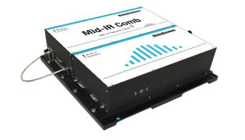
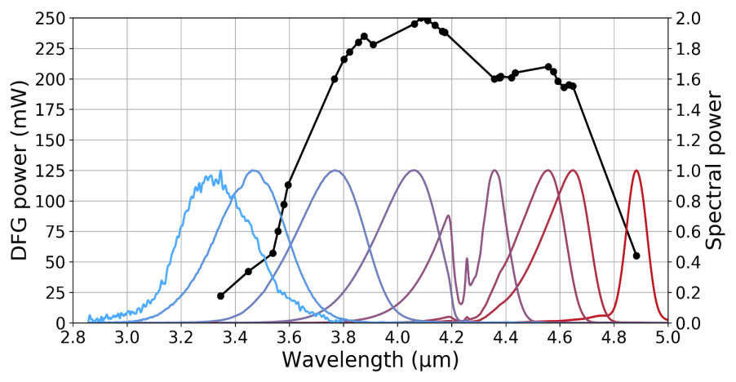
T4.2: DFG in the 4-5 µm range
High DFG output power levels
Wide tuning range between 3-5 µm
High power per mode of tens of µW/mode
Compact laser head
3-5 µm output
42 cm
DFG system head
32 µW/mode

Slide 19
T4.2: Achievements
TASKS | DELIVERABLES
T4.2: Development and test of a metrological difference-frequency-generated mid-infrared frequency comb (MENLO; M1-M24) | D4.2 M8
Definition of the main features of the DFG-MIR-comb prototype (CNR and Menlo)
Development of the DFG-MIR-comb prototype (Menlo)
Improvement of spectral bandwidth, tuning range and output power (Menlo)
high average power generation: >200 mW @ λ = 4.5 µm
high power per mode: 32 µW/mode for a DFG system with 250 MHz repetition rate
ongoing activities:
mid-IR range λ > 5 µm, employing new crystal materials such as OP-GaP
beyond 5 µm Menlo demonstrated an output power of up to 2.7 mW, which is limited but still a good result for high-repetition rate, fully stabilized frequency comb systems in this wavelength range
record low optical linewidth of < 1 Hz for a DFG mid-IR frequency comb system

Slide 20
WP4 Bottlenecks & lessons
TASK | Problem | Solution
T4.1 | Non-classicality of QCL combs with multimode emission could be non-trivial to detect Correlations shared among many modes are non-trivial to detect; Gain and loss could degrade quantum correlations. | CNR-INO asked ETH for new devices: Minimum cavity losses and narrowband gain (e.g. with low doping) Optimized χ⁽³⁾ / χ⁽¹⁾ nonlinearity; Number of modes as low as possible (3); larger mode spacing for simplifying the study of correlations.
T4.1 | currently used detectors (InSb IR) are limiting the detection of squeezing for low saturation intensity; high background noise; low bandwidth. | testing new detectors (MCT, received in March 2020); waiting for QCD developed by CNRS.

Slide 21
WP4 Bottlenecks & lessons
TASK | Problem | Solution
T4.1 | Non-classicality of QCL combs with multimode emission could be non-trivial to detect Correlations shared among many modes are non-trivial to detect; Gain and loss could degrade quantum correlations. | CNR-INO asked ETH for new devices: Minimum cavity losses and narrowband gain (e.g. with low doping) Optimized χ⁽³⁾ / χ⁽¹⁾ nonlinearity; Number of modes as low as possible (3); larger mode spacing for simplifying the study of correlations.
T4.1 | currently used detectors (InSb IR) are limiting the detection of squeezing for low saturation intensity; high background noise; low bandwidth. | testing new detectors (MCT, received in March 2020); waiting for QCD developed by CNRS.
T4.2 | DFG comb with λ > 5 μm with low-power emission wavelenght region difficult to access with DFG (lack of high-efficiency nonlinear crystals). | improving mode matching in the crystals; exploring new nonlinear materials.

Slide 22
T4.2: Deliverables
TASKS | DELIVERABLES
T4.2: Development and test of a metrological difference-frequency-generated mid-infrared frequency comb (MENLO; M1-M24) | D4.2 M8
Definition of the main features of the DFG-MIR-comb prototype (CNR and Menlo)
Development of the DFG-MIR-comb prototype (Menlo)
Improvement of spectral bandwidth, tuning range and output power (Menlo)
D4.2: Prototype of metrological DFG mid-infrared comb with fixed emission wavelength delivered to CNR (Menlo - M8)
Delivered
Installation: mid September 2019

Slide 23
Outline
TASKS | DELIVERABLES
T4.1: Characterization of QCL-combs (CNR; M1-M36) T4.1.1: Characterization of available QCL-combs (M1-M10) T4.1.2: Characterization of new-generation QCL-combs (M6-M36) T4.1.3: Squeezing detection in QCL-combs using new-generation QCDs (M11-M36) | D4.1 M10 D4.3 M12, D4.4 M30 D4.6 M24
T4.2: Development and test of a metrological difference-frequency-generated mid-infrared frequency comb (MENLO; M1-M24) | D4.2 M8
T4.3: QCDs and QWIPs characterization (CNRS; M12-M36) | D4.5 M30
T4.4: Characterization of QCL-comb sensing systems (IRS; M1-M24) T4.4.1: Characterization of state-of-the-art QCL-comb sensing systems (M1-06) T4.4.2: Characterization of quantum-simulation-optimized lasers in spectroscopy system (M7-M24) T4.4.3: Dual-comb spectroscopy with quantum detectors (M9-M24) | D4.10 M6 D4.11 M24 D4.7 M24
T4.5: Development and characterization of ultra-low noise current drivers (PPQS, CNR, ASI, CNRS, ALPES, TRT and IRS; M1-M30) T4.5.1: Fabrication of currently-available current drivers for project partners (M1-M6) T4.5.2: Development and testing of ultra-low noise current drivers (M7-M30) | D4.8 M6 D4.9 M30
T4.6: Characterization of (new-generation) QCL-combs using Ultra High-Q Whispering Gallery mode Resonators (ASI, CNR; M4-M30) | D4.12 M27
Carlo Sirtori
Yanko Todorov
MILESTONES: MS7-M26, MS8-M30, CNR

Slide 24
T4.3: Objectives
TASKS | DELIVERABLES
T4.3: QCDs and QWIPs characterization (CNRS; M12-M36) | D4.5 M30
Full optical and electrical characterization of detectors fabricated in double-metal structures: spectral response, responsivity, gain, NEP (CNRS)

Slide 25
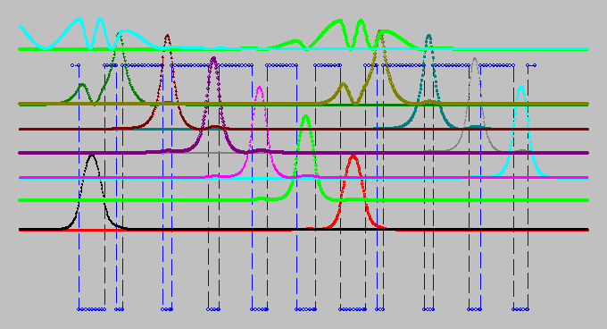
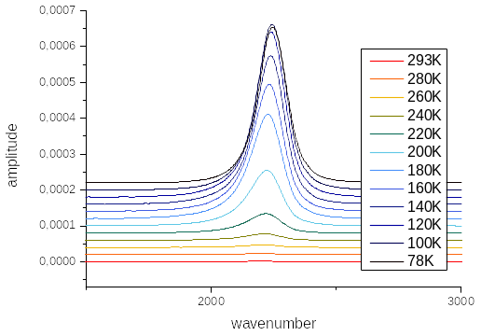
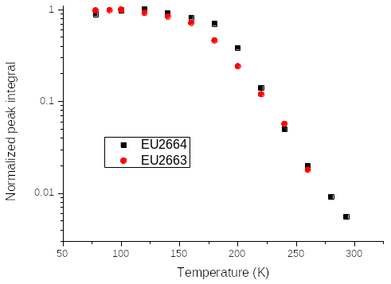
T4.3: Objectives
TASKS | DELIVERABLES
T4.3: QCDs and QWIPs characterization (CNRS; M12-M36) | D4.5 M30
Full optical and electrical characterization of detectors fabricated in double-metal structures: spectral response, responsivity, gain, NEP (CNRS)
D4.5: New-generation QCD characterized, shared with CNR for squeezing detection and delivered to TRT and IRS (CNRS - M24)
Work in
progress

Slide 26
Outline
TASKS | DELIVERABLES
T4.1: Characterization of QCL-combs (CNR; M1-M36) T4.1.1: Characterization of available QCL-combs (M1-M10) T4.1.2: Characterization of new-generation QCL-combs (M6-M36) T4.1.3: Squeezing detection in QCL-combs using new-generation QCDs (M11-M36) | D4.1 M10 D4.3 M12, D4.4 M30 D4.6 M24
T4.2: Development and test of a metrological difference-frequency-generated mid-infrared frequency comb (MENLO; M1-M24) | D4.2 M8
T4.3: QCDs and QWIPs characterization (CNRS; M12-M36) | D4.5 M30
T4.4: Characterization of QCL-comb sensing systems (IRS; M1-M24) T4.4.1: Characterization of state-of-the-art QCL-comb sensing systems (M1-06) T4.4.2: Characterization of quantum-simulation-optimized lasers in spectroscopy system (M7-M24) T4.4.3: Dual-comb spectroscopy with quantum detectors (M9-M24) | D4.10 M6 D4.11 M24 D4.7 M24
T4.5: Development and characterization of ultra-low noise current drivers (PPQS, CNR, ASI, CNRS, ALPES, TRT and IRS; M1-M30) T4.5.1: Fabrication of currently-available current drivers for project partners (M1-M6) T4.5.2: Development and testing of ultra-low noise current drivers (M7-M30) | D4.8 M6 D4.9 M30
T4.6: Characterization of (new-generation) QCL-combs using Ultra High-Q Whispering Gallery mode Resonators (ASI, CNR; M4-M30) | D4.12 M27
Andreas Hugi
Pitt Allmendinger
MILESTONES: MS7-M26, MS8-M30, CNR

Slide 27
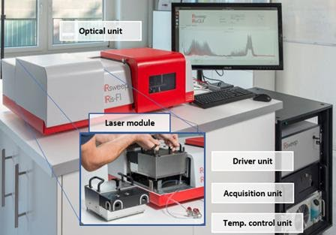
T4.4: Objectives & Deliverables
TASKS | DELIVERABLES
T4.4: Characterization of QCL-comb sensing systems (IRS; M1-M24) T4.4.1: Characterization of state-of-the-art QCL-comb sensing systems (M1-06) T4.4.2: Characterization of quantum-simulation-optimized lasers in spectroscopy system (M7-M24) T4.4.3: Dual-comb spectroscopy with quantum detectors (M9-M24) | D4.10 M6 D4.11 M24 D4.7 M24
Fabrication of dedicated state-of-the-art dual-comb system (IRS)
Evaluation of noise contributions for the sources, detectors and electronics (IRS)
Characterization of frequency and mode-spacing stability (IRS)
D4.10: Report on the limiting factors of current dual-comb systems and performance improvements from the lasers and quantum detectors developed in the project (IRS - M6)
Delivered!
Main potential improvements:
Lower detectors dark counts (improve dynamical range);
More reliable QCL-combs with less sub comb modes;
Low noise drivers for better frequency stability.

Slide 28
T4.4: Objectives & Deliverables
TASKS | DELIVERABLES
T4.4: Characterization of QCL-comb sensing systems (IRS; M1-M24) T4.4.1: Characterization of state-of-the-art QCL-comb sensing systems (M1-06) T4.4.2: Characterization of quantum-simulation-optimized lasers in spectroscopy system (M7-M24) T4.4.3: Dual-comb spectroscopy with quantum detectors (M9-M24) | D4.10 M6 D4.11 M24 D4.7 M24
Integration of novel laser components in the dual-comb system (IRS/ETH)
Validation of the performance of the new ‘quantum’ devices for sensing applications
Laser drivers
NEW dual-laser driver in one unit instead of having two separate units. This opens a direct integration into the IRis-Fi1 control unit. A prototype is under construction and will be tested soon.
D4.11: Report on noise performance of the different generations of devices developed in the project (IRS - M24)
Work in progress

Slide 29
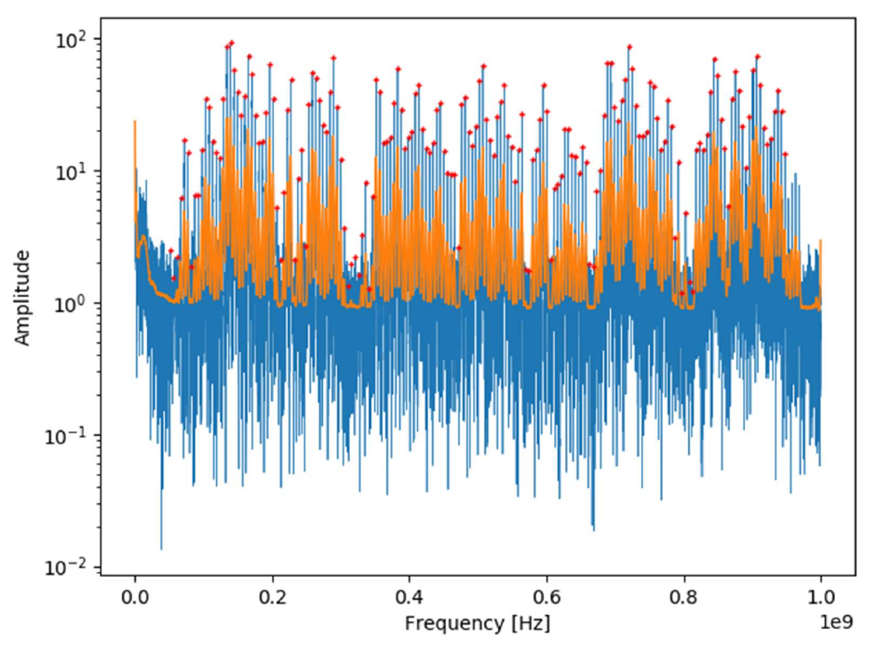
T4.4: Objectives & Deliverables
TASKS | DELIVERABLES
T4.4: Characterization of QCL-comb sensing systems (IRS; M1-M24) T4.4.1: Characterization of state-of-the-art QCL-comb sensing systems (M1-06) T4.4.2: Characterization of quantum-simulation-optimized lasers in spectroscopy system (M7-M24) T4.4.3: Dual-comb spectroscopy with quantum detectors (M9-M24) | D4.10 M6 D4.11 M24 D4.7 M24
Integration of QCD and QWIP detectors in the dual-comb system (IRS/CNRS)
Validation of the performance of the new detectors, comparison with MCT detectors (IRS)
Two lasers delivered from Alpes have been characterized:
good frequency stability, no subcombs
almost complete superposition of combs
good performance for the spectrometer for sensing applications

Slide 30
WP4 Bottlenecks & lessons
TASK | Problem | Solution
T4.1 | Non-classicality of QCL combs with multimode emission could be non-trivial to detect Correlations shared among many modes are non-trivial to detect; Gain and loss could degrade quantum correlations. | CNR-INO asked ETH for new devices: Minimum cavity losses and narrowband gain (e.g. with low doping) Optimized χ⁽³⁾ / χ⁽¹⁾ nonlinearity; Number of modes as low as possible (3); larger mode spacing for simplifying the study of correlations.
T4.1 | currently used detectors (InSb IR) are limiting the detection of squeezing for low saturation intensity; high background noise; low bandwidth. | testing new detectors (MCT, received in March 2020); waiting for QCD developed by CNRS.
T4.2 | DFG comb with λ > 5 μm with low-power emission wavelenght region difficult to access with DFG (lack of high-efficiency nonlinear crystals). | improving mode matching in the crystals; exploring new nonlinear materials.

Slide 31
WP4 Bottlenecks & lessons
TASK | Problem | Solution
T4.1 | Non-classicality of QCL combs with multimode emission could be non-trivial to detect Correlations shared among many modes are non-trivial to detect; Gain and loss could degrade quantum correlations. | CNR-INO asked ETH for new devices: Minimum cavity losses and narrowband gain (e.g. with low doping) Optimized χ⁽³⁾ / χ⁽¹⁾ nonlinearity; Number of modes as low as possible (3); larger mode spacing for simplifying the study of correlations.
T4.1 | currently used detectors (InSb IR) are limiting the detection of squeezing for low saturation intensity; high background noise; low bandwidth. | testing new detectors (MCT, received in March 2020); waiting for QCD developed by CNRS.
T4.2 | DFG comb with λ > 5 μm with low-power emission wavelenght region difficult to access with DFG (lack of high-efficiency nonlinear crystals). | improving mode matching in the crystals; exploring new nonlinear materials.
T4.4 | Cryogenic detectors (current version of CNRS QCDs) cannot be integrated into the spectrometer cryocooling systems are unsuitable for on-field instrumentation. | improving operating temperature of QCDs with better MBE growing conditions; using MCT detectors.

Slide 32
T4.4: Objectives & Deliverables
TASKS | DELIVERABLES
T4.4: Characterization of QCL-comb sensing systems (IRS; M1-M24) T4.4.1: Characterization of state-of-the-art QCL-comb sensing systems (M1-06) T4.4.2: Characterization of quantum-simulation-optimized lasers in spectroscopy system (M7-M24) T4.4.3: Dual-comb spectroscopy with quantum detectors (M9-M24) | D4.10 M6 D4.11 M24 D4.7 M24
Integration of QCD and QWIP detectors in the dual-comb system (IRS/CNRS)
Validation of the performance of the new detectors, comparison with MCT detectors (IRS)
D4.7: Device-performance for sensing applications validated in dual-QCL-comb system (IRS - M36)
Work in progress
IRsweep is waiting for quantum detectors from CNRS for testing.

Slide 33
Outline
TASKS | DELIVERABLES
T4.1: Characterization of QCL-combs (CNR; M1-M36) T4.1.1: Characterization of available QCL-combs (M1-M10) T4.1.2: Characterization of new-generation QCL-combs (M6-M36) T4.1.3: Squeezing detection in QCL-combs using new-generation QCDs (M11-M36) | D4.1 M10 D4.3 M12, D4.4 M30 D4.6 M24
T4.2: Development and test of a metrological difference-frequency-generated mid-infrared frequency comb (MENLO; M1-M24) | D4.2 M8
T4.3: QCDs and QWIPs characterization (CNRS; M12-M36) | D4.5 M30
T4.4: Characterization of QCL-comb sensing systems (IRS; M1-M24) T4.4.1: Characterization of state-of-the-art QCL-comb sensing systems (M1-06) T4.4.2: Characterization of quantum-simulation-optimized lasers in spectroscopy system (M7-M24) T4.4.3: Dual-comb spectroscopy with quantum detectors (M9-M24) | D4.10 M6 D4.11 M24 D4.7 M24
T4.5: Development and characterization of ultra-low noise current drivers (PPQS, CNR, ASI, CNRS, ALPES, TRT and IRS; M1-M30) T4.5.1: Fabrication of currently-available current drivers for project partners (M1-M6) T4.5.2: Development and testing of ultra-low noise current drivers (M7-M30) | D4.8 M6 D4.9 M30
T4.6: Characterization of (new-generation) QCL-combs using Ultra High-Q Whispering Gallery mode Resonators (ASI, CNR; M4-M30) | D4.12 M27
Davide Mazzotti
Saverio Bartalini
MILESTONES: MS7-M26, MS8-M30, CNR

Slide 34
T4.5: Objectives & Deliverables
TASKS | DELIVERABLES
T4.5: Development and characterization of ultra-low noise current drivers (PPQS, CNR, ASI, CNRS, ALPES, TRT and IRS; M1-M30) T4.5.1: Fabrication of currently-available current drivers for project partners (M1-M6) T4.5.2: Development and testing of ultra-low noise current drivers (M7-M30) | D4.8 M6 D4.9 M30
Fabrication of (5) low-noise drivers and delivery to partners (ppqS)
D4.8: Commercial ultra-low noise current drivers fabricated and
delivered to partners (ppqSense – M6)
Delivered!

Slide 35
T4.5: Objectives & Deliverables
TASKS | DELIVERABLES
T4.5: Development and characterization of ultra-low noise current drivers (PPQS, CNR, ASI, CNRS, ALPES, TRT and IRS; M1-M30) T4.5.1: Fabrication of currently-available current drivers for project partners (M1-M6) T4.5.2: Development and testing of ultra-low noise current drivers (M7-M30) | D4.8 M6 D4.9 M30
Design of improved-features drivers for quantum experiments (ppqS)
Characterization of the novel drivers and distribution (7) to the partners (ppqS)
Development of 3+5 additional drivers for internal characterization purposes and for the market (ppqS)
D4.9: New features and improved performances implemented on new-generation current drivers and delivered to partners (ppqSense - M30)
Work in progress

Slide 36
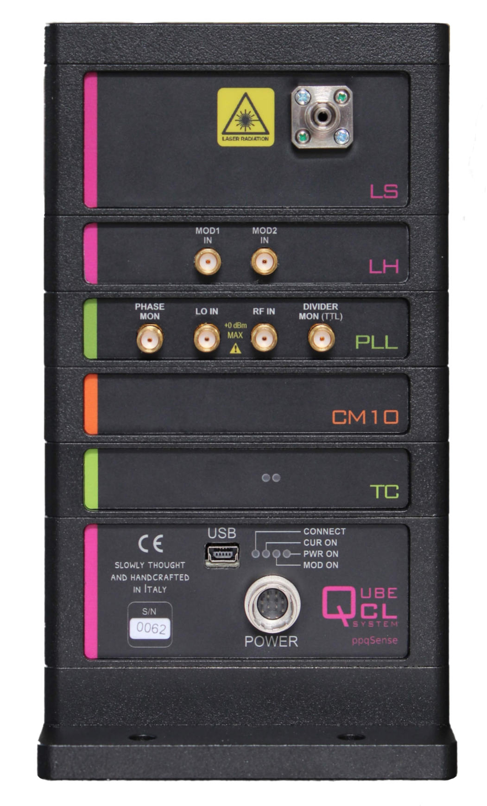
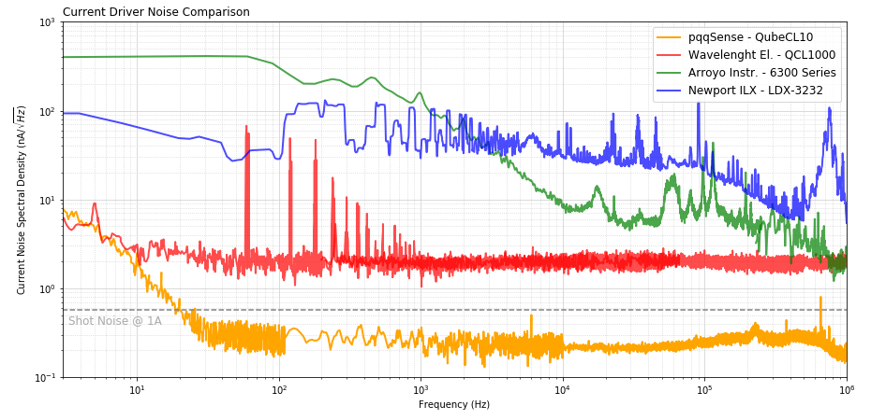
T4.5: Achievements
lowest current noise on the market: flat and 10 times lower than the best competitor driver.
Comparison with main commercial drivers:
Patent pending
(EU and US)

Slide 37
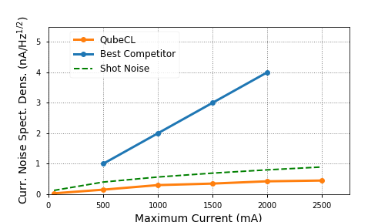
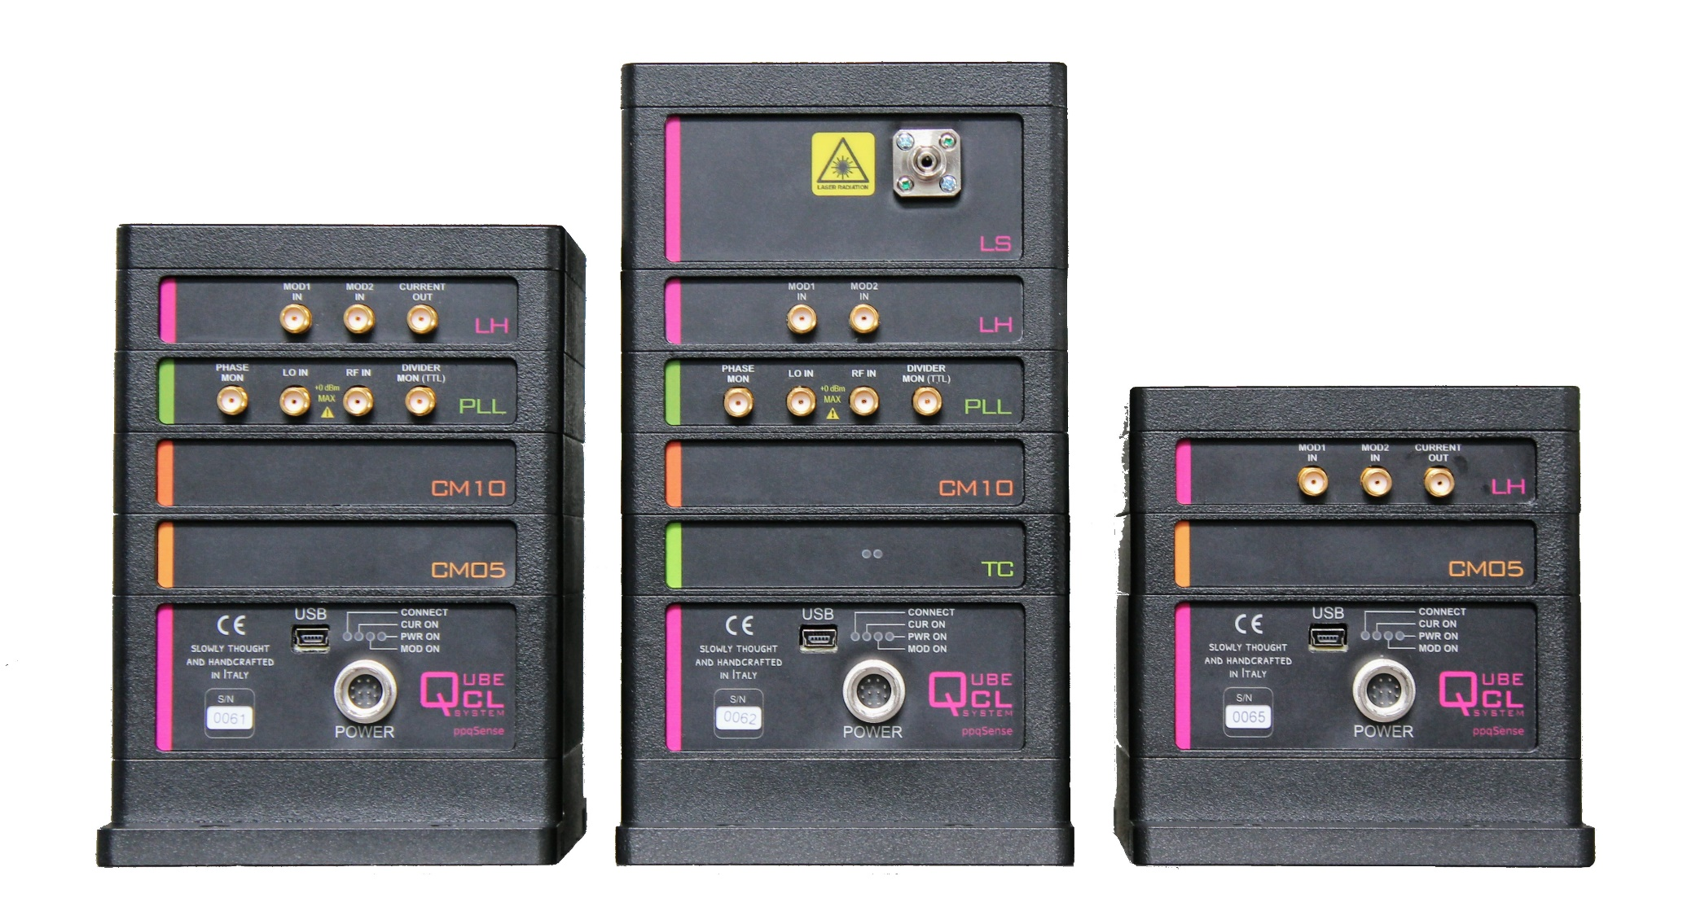
T4.5: Achievements
A sub-shot noise current source for any output current
Designed for lowest current noise over a wide range of output currents, up to 2.5 A.
Two different current modules are provided.
patented modularity $→$larger current outputs by combining 2 or more current modules.
This allows to overcome the typical linear dependence of the current noise on the max. current available (i.e. the internal sensing resistor).
When combining two or more modules, the current noises add in quadrature and the total noise scales as the sqrt of the max current.

Slide 38
 | Max curr | Noise, typ | Noise, max
CD05 | 500 mA | < 150 pA/Hz^{1/2} | < 400 pA/Hz^{1/2}
CD10 | 1000 mA | < 300 pA/Hz^{1/2} | < 600 pA/Hz^{1/2}
 | Max curr | Noise, typ | Noise, max
CD05 | 0.5 A | < 150 pA/Hz^{1/2} | < 400 pA/Hz^{1/2}
CD10 | 1 A | < 300 pA/Hz^{1/2} | < 600 pA/Hz^{1/2}
CD15 | 1.5 A | < 350 pA/Hz^{1/2} | < 1 nA/Hz^{1/2}
CD20 | 2 A | < 425 pA/Hz^{1/2} | < 1 nA/Hz^{1/2}
CD25 | 2.5 A | < 450 pA/Hz^{1/2} | < 1 nA/Hz^{1/2}

Slide 39
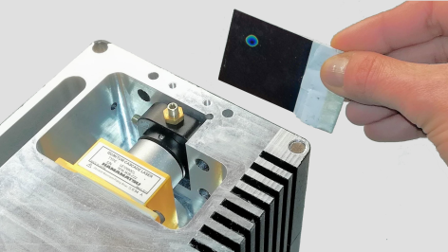
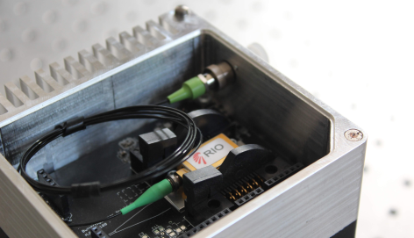
T4.5: Ongoing
Ongoing activities
HHL-packaged QCL
housing module
Butterfly-packaged lasers
housing module
Lock-in module
for frequecy-modulation spectroscopy
Pound-Drever-Hall locking module
for locking a laser to a cavity
PID module
for first-derivative locking to a cavity or spectroscopic transition

Slide 40
Outline
TASKS | DELIVERABLES
T4.1: Characterization of QCL-combs (CNR; M1-M36) T4.1.1: Characterization of available QCL-combs (M1-M10) T4.1.2: Characterization of new-generation QCL-combs (M6-M36) T4.1.3: Squeezing detection in QCL-combs using new-generation QCDs (M11-M36) | D4.1 M10 D4.3 M12, D4.4 M30 D4.6 M24
T4.2: Development and test of a metrological difference-frequency-generated mid-infrared frequency comb (MENLO; M1-M24) | D4.2 M8
T4.3: QCDs and QWIPs characterization (CNRS; M12-M36) | D4.5 M30
T4.4: Characterization of QCL-comb sensing systems (IRS; M1-M24) T4.4.1: Characterization of state-of-the-art QCL-comb sensing systems (M1-06) T4.4.2: Characterization of quantum-simulation-optimized lasers in spectroscopy system (M7-M24) T4.4.3: Dual-comb spectroscopy with quantum detectors (M9-M24) | D4.10 M6 D4.11 M24 D4.7 M24
T4.5: Development and characterization of ultra-low noise current drivers (PPQS, CNR, ASI, CNRS, ALPES, TRT and IRS; M1-M30) T4.5.1: Fabrication of currently-available current drivers for project partners (M1-M6) T4.5.2: Development and testing of ultra-low noise current drivers (M7-M30) | D4.8 M6 D4.9 M30
T4.6: Characterization of (new-generation) QCL-combs using Ultra High-Q Whispering Gallery mode Resonators (ASI, CNR; M4-M30) | D4.12 M27
Mario Siciliani de Cumis
MILESTONES: MS7-M26, MS8-M30, CNR

Slide 41
T4.6: Objectives & Deliverables
TASKS | DELIVERABLES
T4.6: Characterization of (new-generation) QCL-combs using Ultra High-Q Whispering Gallery mode Resonators (ASI, CNR; M4-M30) | D4.12 M27
Design of the setup for QCL-comb coupling with WGMRs (ASI, CNR)
Noise characterization and stabilization of QCL combs using WGMRs (ASI, CNR)
Study of short-time evolution of teeth phase fluctuations of QCL-combs (ASI, CNR)
D4.12: Metrological characterization of QCL-comb devices
using WGMR (ASI - M27)
Work in progress

Slide 42
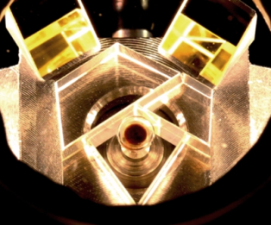
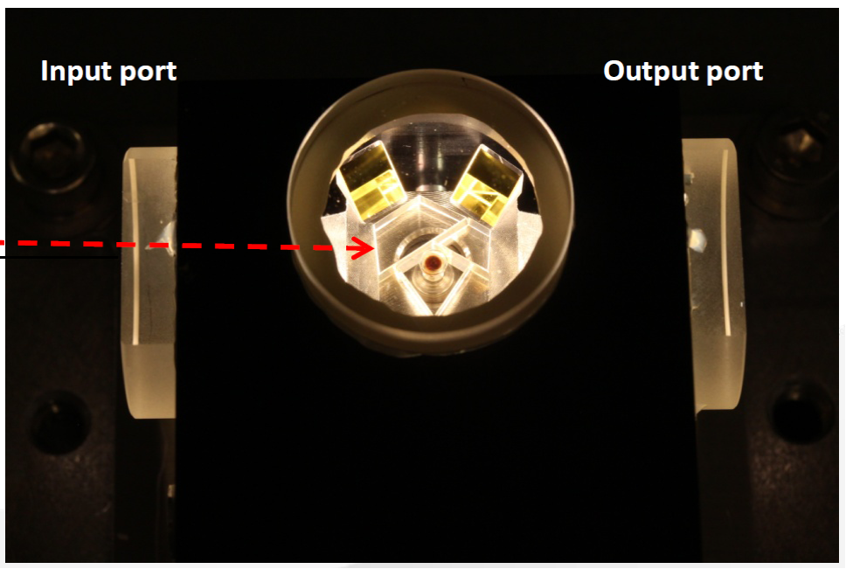
T4.6: Achievements
T4.6: Characterization of (new-generation) QCL-combs using Ultra High-Q Whispering Gallery mode Resonators (ASI, CNR; M4-M30)
ASI designed a custom CaF₂ toroidal WGMR.
It has been realized by OEWaves inc.
FSR expected ~ 20 GHz @ 4.5 mm
Q-factor expected ~2 x 107 @ 4.5 mm
Prism couplig system
Actuators for stabilization
- Thermal actuator
- Fast piezo actuator

Slide 43
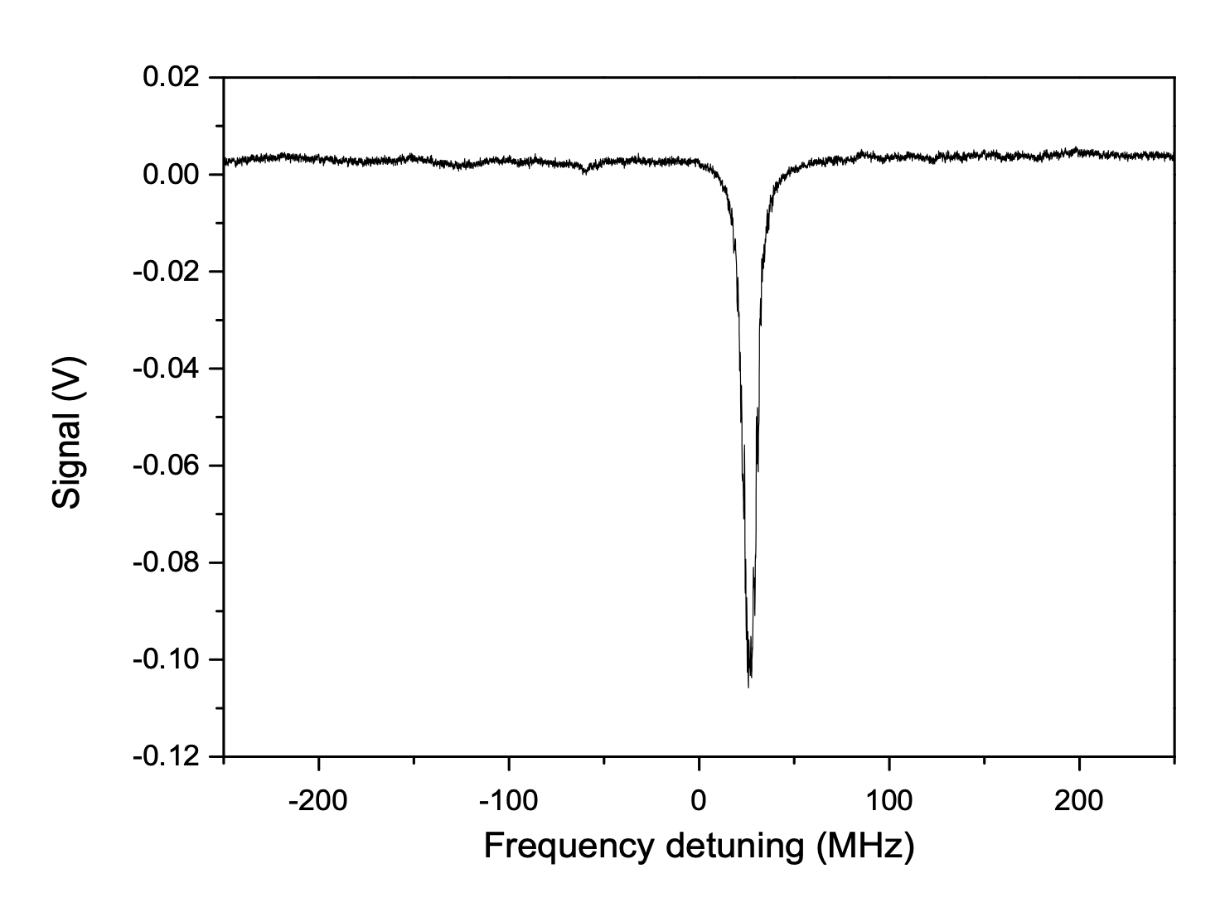
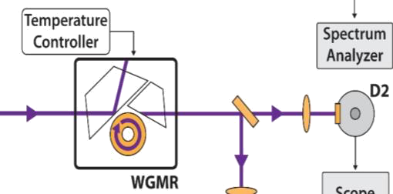
T4.6: Achievements
WGMR preliminary alignment and mode characterization
WGMR as passive devices for filtering or to characterize the light coupled in the cavity using the slope of the transmission modes.
QCL
The resonator is currently under alignment and characterization for determining:
- Q-factor at the QCLs working wavelengths
- Mode width and stability
- Optimal coupling conditions

Slide 44
WP4 Bottlenecks & lessons
TASK | Problem | Solution
T4.1 | Non-classicality of QCL combs with multimode emission could be non-trivial to detect Correlations shared among many modes are non-trivial to detect; Gain and loss could degrade quantum correlations. | CNR-INO asked ETH for new devices: Minimum cavity losses and narrowband gain (e.g. with low doping) Optimized χ⁽³⁾ / χ⁽¹⁾ nonlinearity; Number of modes as low as possible (3); larger mode spacing for simplifying the study of correlations.
T4.1 | currently used detectors (InSb IR) are limiting the detection of squeezing for low saturation intensity; high background noise; low bandwidth. | testing new detectors (MCT, received in March 2020); waiting for QCD developed by CNRS.
T4.2 | DFG comb with λ > 5 μm with low-power emission wavelenght region difficult to access with DFG (lack of high-efficiency nonlinear crystals). | improving mode matching in the crystals; exploring new nonlinear materials.
T4.4 | Cryogenic detectors (current version of CNRS QCDs) cannot be integrated into the spectrometer cryocooling systems are unsuitable for on-field instrumentation. | improving operating temperature of QCDs with better MBE growing conditions; using MCT detectors.

Slide 45
Risk analysis
Risk number | Description of risk | Likelihood | Proposed risk-mitigation measures
7 | Homodyne detection scheme cannot reveal squeezing in QCL-combs | Medium | Another run of simulation-fabrication is required in order to produce lower-noise devices
8 | QCDs and QWIPs do not have the required sensitivity for noise characterization of QCL-combs | Medium | Another run of simulation-design-fabrication of this structures will be carried out. Meanwhile QCDs and QWIPs will be replaced by standard infrared detectors for QCL-combs characterization
These risks have not materialized up to now. First check planned for September 2020 (M24).
No unforeseen risk for the moment.

Slide 46
Summary
TASKS | DELIVERABLES
T4.1: Characterization of QCL-combs (CNR; M1-M36) T4.1.1: Characterization of available QCL-combs (M1-M10) T4.1.2: Characterization of new-generation QCL-combs (M6-M36) T4.1.3: Squeezing detection in QCL-combs using new-generation QCDs (M11-M36) | D4.1 M10 D4.3 M12, D4.4 M30 D4.6 M24
T4.2: Development and test of a metrological difference-frequency-generated mid-infrared frequency comb (MENLO; M1-M24) | D4.2 M8
T4.3: QCDs and QWIPs characterization (CNRS; M12-M36) | D4.5 M30
T4.4: Characterization of QCL-comb sensing systems (IRS; M1-M24) T4.4.1: Characterization of state-of-the-art QCL-comb sensing systems (M1-06) T4.4.2: Characterization of quantum-simulation-optimized lasers in spectroscopy system (M7-M24) T4.4.3: Dual-comb spectroscopy with quantum detectors (M9-M24) | D4.10 M6 D4.11 M24 D4.7 M24
T4.5: Development and characterization of ultra-low noise current drivers (PPQS, CNR, ASI, CNRS, ALPES, TRT and IRS; M1-M30) T4.5.1: Fabrication of currently-available current drivers for project partners (M1-M6) T4.5.2: Development and testing of ultra-low noise current drivers (M7-M30) | D4.8 M6 D4.9 M30
T4.6: Characterization of (new-generation) QCL-combs using Ultra High-Q Whispering Gallery mode Resonators (ASI, CNR; M4-M30) | D4.12 M27
MILESTONES: MS7-M26, MS8-M30, CNR

Slide 47
Thank you

