Slide 1



WP 3
Martin Franckie
Jerome Faist
Giacomo Scalari
Mattias Beck
Barbara Schneider
Matthew Singleton
Filippos Kapsalidis
Mathieu Bertrand
Josefine Enkner
ETHZ
Carlo Sirtori
Yanko Todorov
Angela Vasanelli
Azzurra Bigioli
CNRS
Richard Maulini
Antoine Müller
Sargis Hakobyan
ALPES
Mid-term Review meeting
May 13th 2020
The Qombs Project is funded by the European Union’s Horizon 2020 research and innovation programme under grant agreement number 820419

Slide 2
Tasks:
T3.1 M1-M3: Identification of existing QCL-comb devices (ETHZ)
T3.2 M3-M9: QCL-comb fabrication using existing technology and AR designs (ETHZ)
T3.3 M3-M9: Fabrication tolerances (ALPES)
T3.4 M9-M24: Fabrication and basic characterization of new comb devices (ETHZ)
T3.5 M25-M33: Further generation of devices (ETHZ)
T3.6 M24-M36: Mass production of improved devices (ALPES)
T3.7 M1-M24 : Fabrication of QCDs (CNRS + ETHZ)
Deliverables:
D3.1 M3
D3.3 M9
D3.4 M24
D3.5 M33
D3.6 M30
D3.2 M3
D3.7 M24
Milestones
MS3.1 M24 (ETHZ)
MS3.2 M27 (CNRS)

Slide 3
Tasks:
T3.1 M1-M3: Identification of existing QCL-comb devices (ETHZ)
T3.2 M3-M9: QCL-comb fabrication using existing technology and AR designs (ETHZ)
T3.3 M3-M9: Fabrication tolerances (ALPES)
T3.4 M9-M24: Fabrication and basic characterization of new comb devices (ETHZ)
T3.5 M25-M33: Further generation of devices (ETHZ)
T3.6 M24-M36: Mass production of improved devices (ALPES)
T3.7 M1-M24 : Fabrication of QCDs (CNRS + ETHZ)
Deliverables:
D3.1 M3
D3.3 M9
D3.4 M24
D3.5 M33
D3.6 M30
D3.2 M3
D3.7 M24
Milestones
MS3.1 M24 (ETHZ)
MS3.2 M27 (CNRS)

Slide 4
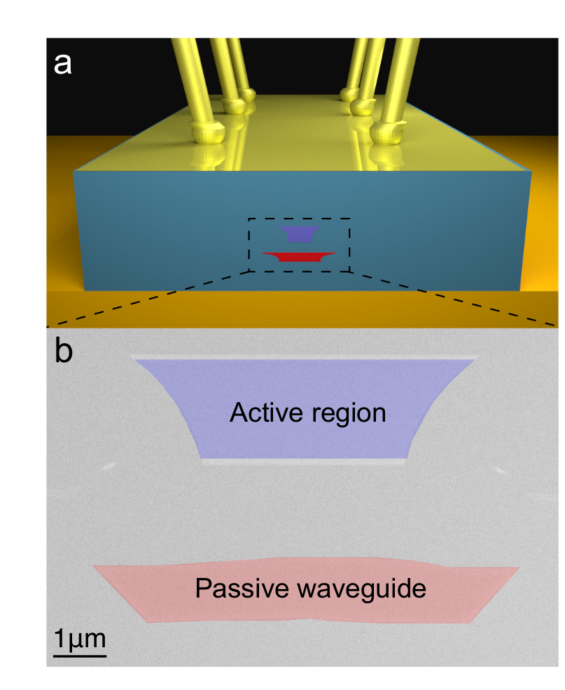
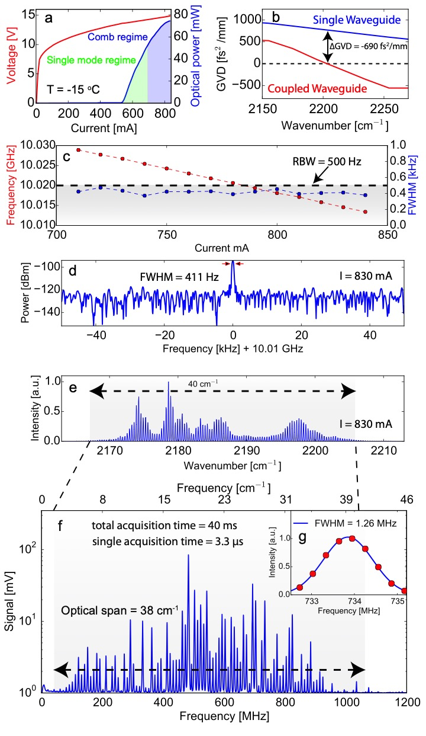
Task 3.1
Goal: Identify and deliver already fabricated, best comb devices @4.5 μm,
from ETH to CNR-INO
Delivered:
dual-waveguide comb QCL at 4.5 μm [1]
two combs at 7.8 μm (for CNRS detector setup)
[1] Y. Bidaux,F. Kapsalidis, P. Jouy, M. Beck, and J. Faist, “Coupled-waveguides for dispersion compensation in semiconductor lasers”, Laser Photonics Rev. 12, 1700323 (2018)

Slide 5
Tasks:
T3.1 M1-M3: Identification of existing QCL-comb devices (ETHZ)
T3.2 M3-M9: QCL-comb fabrication using existing technology and AR designs (ETHZ)
T3.3 M3-M9: Fabrication tolerances (ALPES)
T3.4 M9-M24: Fabrication and basic characterization of new comb devices (ETHZ)
T3.5 M25-M33: Further generation of devices (ETHZ)
T3.6 M24-M36: Mass production of improved devices (ALPES)
T3.7 M1-M24 : Fabrication of QCDs (CNRS + ETHZ)
Deliverables:
D3.1 M3
D3.3 M9
D3.4 M24
D3.5 M33
D3.6 M30
D3.2 M3
D3.7 M24
Milestones
MS3.1 M24 (ETHZ)
MS3.2 M27 (CNRS)

Slide 6
Task 3.2
Goals:
Baseline for QCL comb fabrication
Growth and fabrication of existing designs
Characterize and identify potentials for improvement
Delivered:
Identified several areas for fabrication improvement:
  Dry etching of laser ridges (ETH)
  Radio frequency injection efficiency (ETH)
  Optimizing ridge width (ETH + ALPES)
  Dispersion control via top cladding (ALPES)
ETH sent three 4.5 μm comb devices to CNR-INO

Slide 7
Task 3.2
Goals:
Baseline for QCL comb fabrication
Growth and fabrication of existing designs
Characterize and identify potentials for improvement
Delivered:
Identified several areas for fabrication improvement:
  Dry etching of laser ridges (ETH)
  Radio frequency injection efficiency (ETH)
  Optimizing ridge width (ETH + ALPES)
  Dispersion control via top cladding (ALPES)
ETH sent three 4.5 μm comb devices to CNR-INO

Slide 8
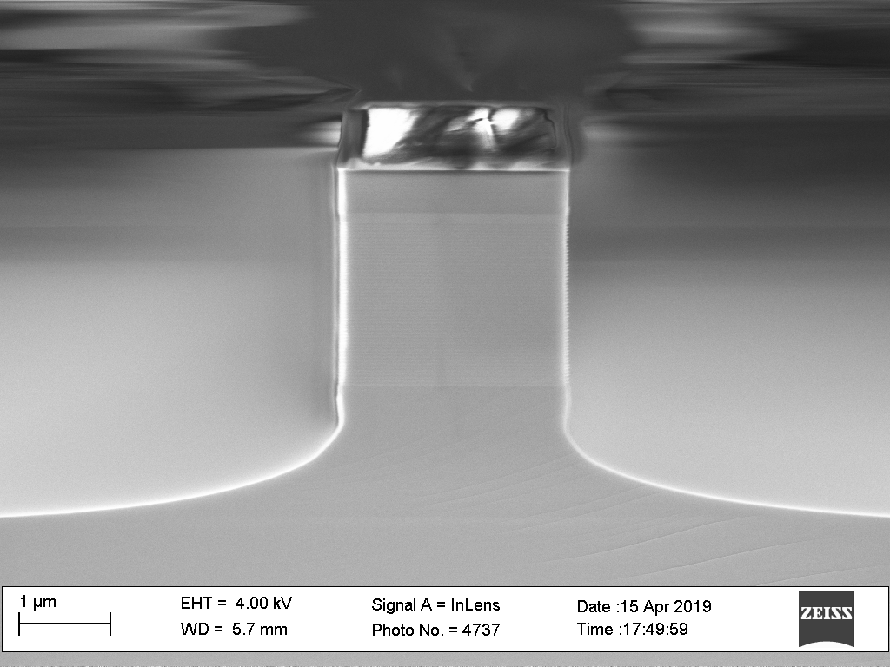
Task 3.2
  Dry etching of laser ridges (ETH)
Status at M1
Ongoing investigations
Heat flux
Passive
~3 μm
Active
Straight walls achieved
Optimizing re-growth
Expect improved:
  Heat extraction
  Gain
  Dispersion control
Problems:
Heat extraction
Lower gain
Dispersion control

Slide 9
Task 3.2
Goals:
Baseline for QCL comb fabrication
Growth and fabrication of existing designs
Characterize and identify potentials for improvement
Delivered:
Identified several areas for fabrication improvement:
  Dry etching of laser ridges (ETH)
  Radio frequency injection efficiency (ETH)
  Optimizing ridge width (ETH + ALPES)
  Dispersion control via top cladding (ALPES)
ETH sent three 4.5 μm comb devices to CNR-INO

Slide 10
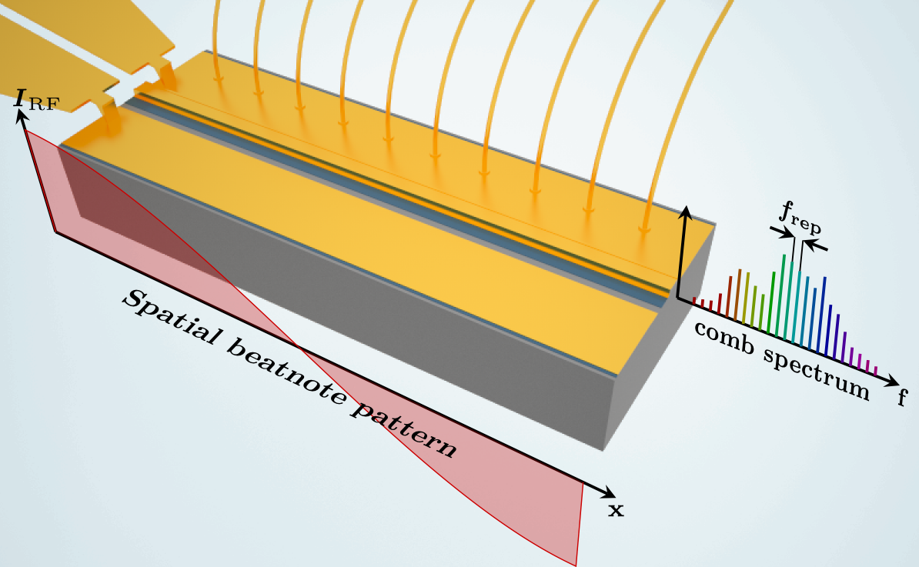
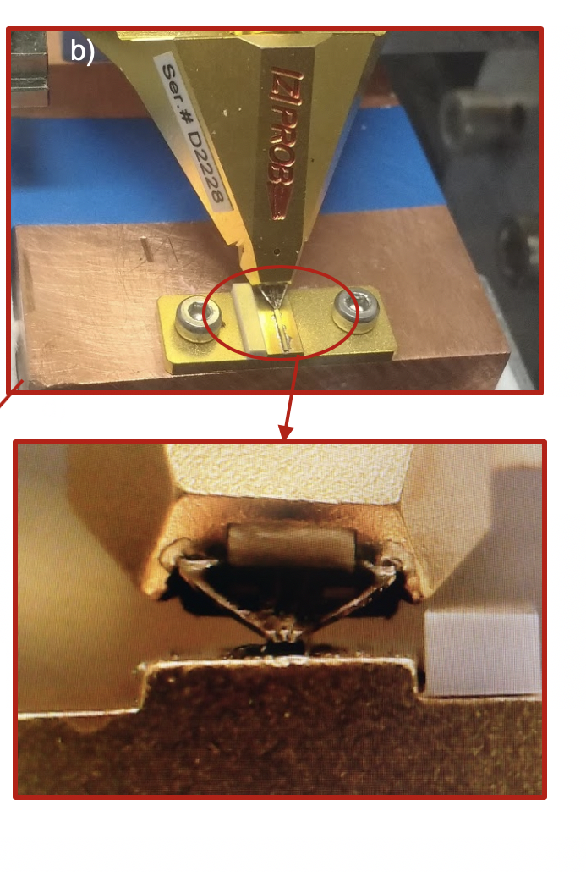
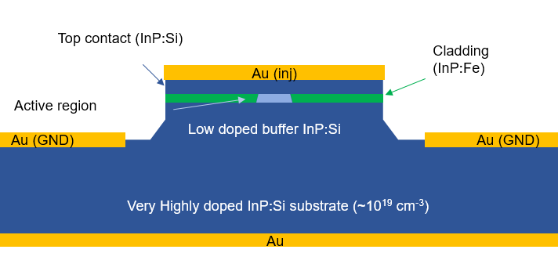
Task 3.2
  Radio frequency injection efficiency (ETH)
Status at M1
Ongoing investigations
Low-RF-loss QCLs
Low capacitance:
  High-doped subs.
  Top clading
  Narrow waveguide
RF probe setup
I-V curves
Spectra (Task 3.4)
High RF efficiency:
Active mode locking:
RF injection close
to f_{rep} locks comb
Narrow wires:
Poor injection efficiency
Study of RF response due to other factors not possible
B. Schneider, F. Kapsalidis, M. Singleton, M. Beck and J. Faist
“ RF Study of Quantum Cascade Laser Optical Frequency Combs”
Optical Sensing Autumn School 19, Tromsö
Figure from:
Hillbrand et al., Nature Photonics 13, 101-104 (2019)

Slide 11
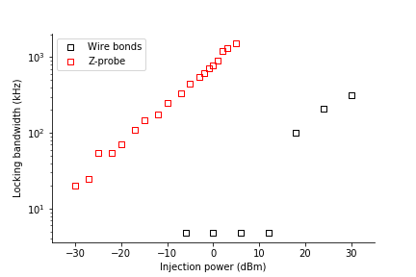
Task 3.2
  Radio frequency injection efficiency (ETH)
Status at M1
Ongoing investigations
Low-RF-loss QCLs
Low capacitance:
  High-doped subs.
  Top clading
  Narrow waveguide
RF probe setup
I-V curves
Spectra (Task 3.4)
High RF efficiency:
Active mode locking:
RF injection close
to f_{rep} locks comb
Narrow wires:
Poor injection efficiency
Study of RF response due to other factors not possible
~35 dB
B. Schneider, F. Kapsalidis, M. Singleton, M. Beck and J. Faist
“ RF Study of Quantum Cascade Laser Optical Frequency Combs”
Optical Sensing Autumn School 19, Tromsö
Figure from:
Hillbrand et al., Nature Photonics 13, 101-104 (2019)

Slide 12
Task 3.2
Goals:
Baseline for QCL comb fabrication
Growth and fabrication of existing designs
Characterize and identify potentials for improvement
Delivered:
Identified several areas for fabrication improvement:
  Dry etching of laser ridges (ETH)
  Radio frequency injection efficiency (ETH)
  Optimizing ridge width (ETH + ALPES) (results in Task 3.4)
  Dispersion control via top cladding (ALPES)
ETH sent three 4.5 μm comb devices to CNR-INO

Slide 13
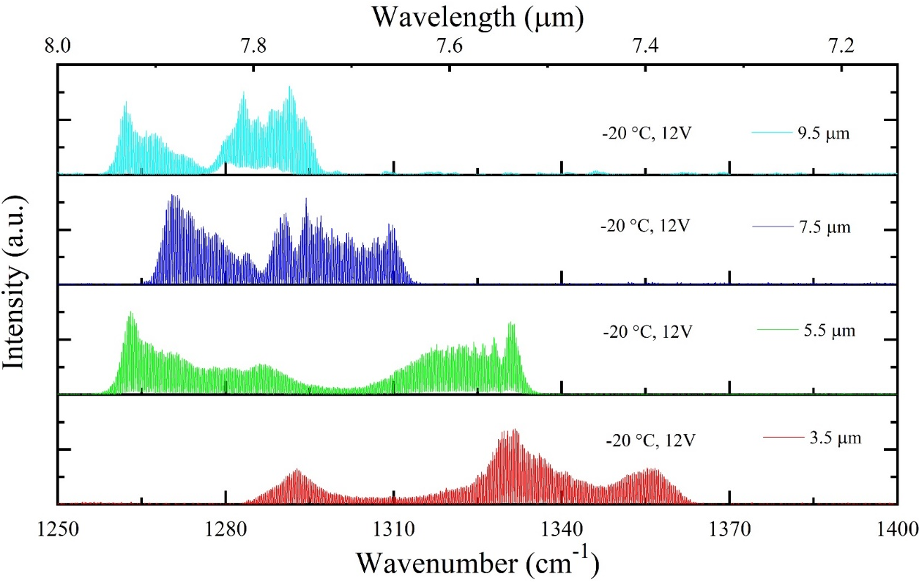
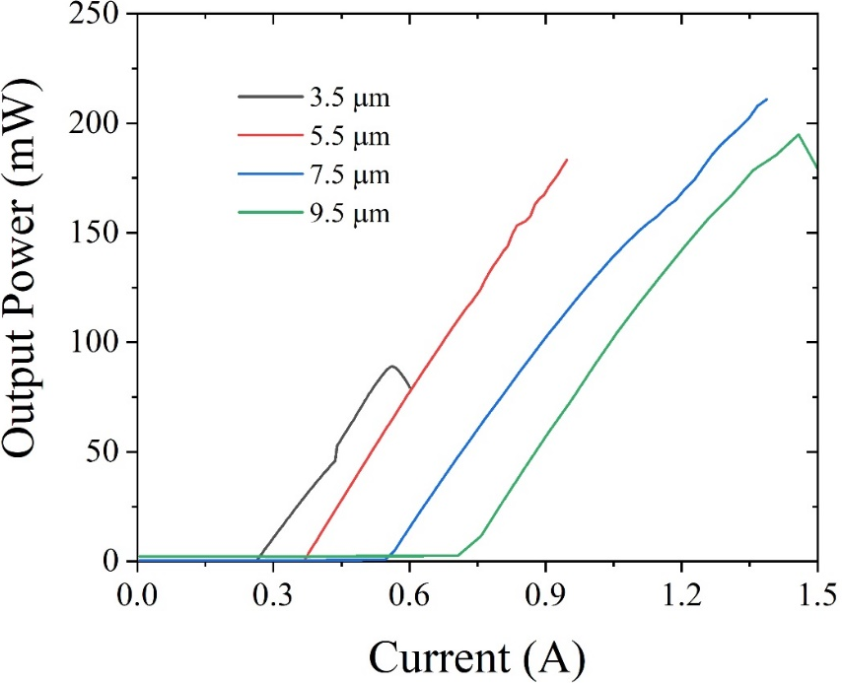
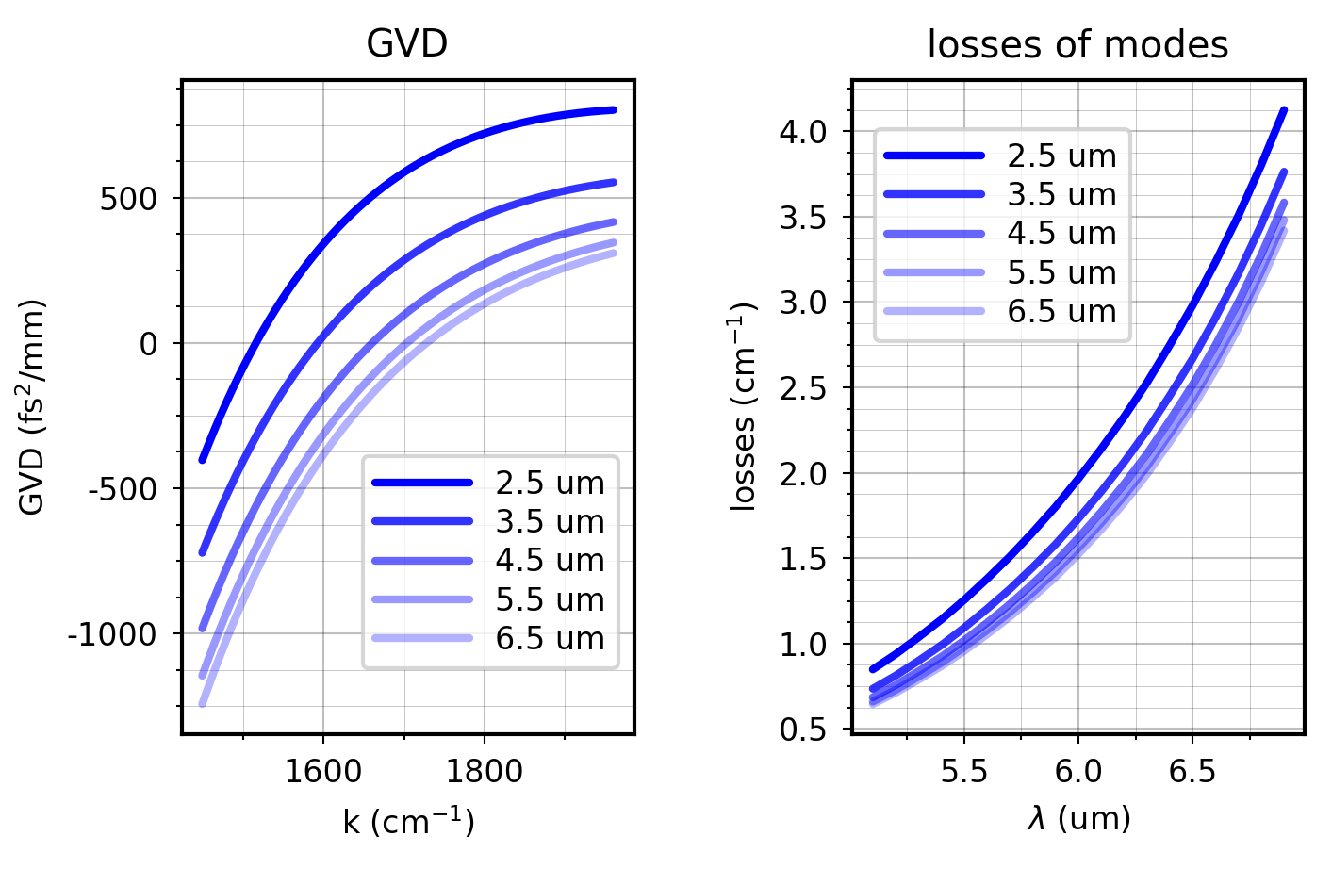
Task 3.2
  Optimizing ridge width (ETH + ALPES)
ETH
7.8 μm QCL combs
Narrower ridges, wider spectrum
  6-8 μm: Δν ≈ 60 cm⁻¹
  3-4 μm: Δν ≈ 100 cm⁻¹
ALPES
6 μm QCL combs
6 μm
Lower GVD
(group velocity dispersion)
allow broader combs
GVD tuned by ridge width:
Narrower ridge for longer λ

Slide 14
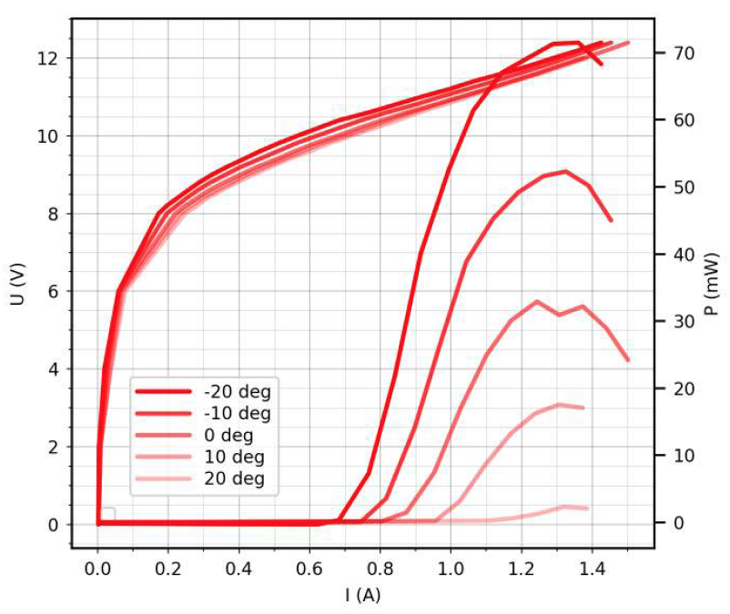
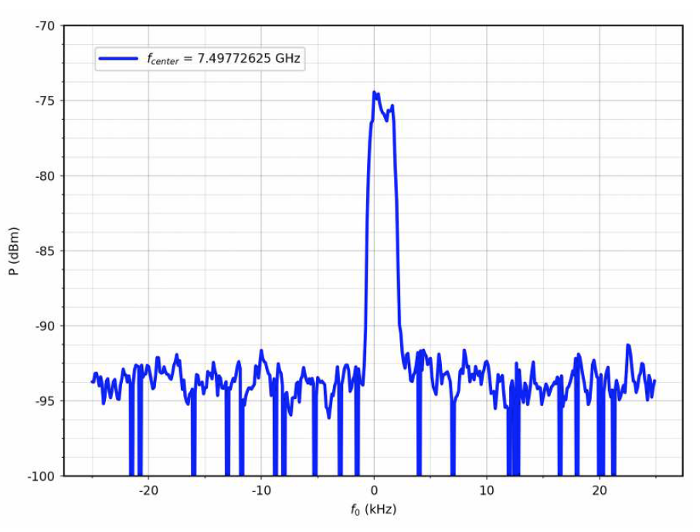
Task 3.2
  Optimizing ridge width (ETH + ALPES)
ETH
7.8 μm QCL combs
Narrower ridges, wider spectrum
  6-8 μm: Δν ≈ 60 cm⁻¹
  3-4 μm: Δν ≈ 100 cm⁻¹
ALPES
Comb operation
6 μm QCL combs
Lower GVD
(group velocity dispersion)
allow broader combs
GVD tuned by ridge width:
Narrower ridge for longer λ

Slide 15
Task 3.2
Goals:
Baseline for QCL comb fabrication
Growth and fabrication of existing designs
Characterize and identify potentials for improvement
Delivered:
Identified several areas for fabrication improvement:
  Dry etching of laser ridges (ETH)
  Radio frequency injection efficiency (ETH)
  Optimizing ridge width (ETH + ALPES)
  Dispersion control via top cladding (ALPES)
ETH sent three 4.5 μm comb devices to CNR-INO

Slide 16
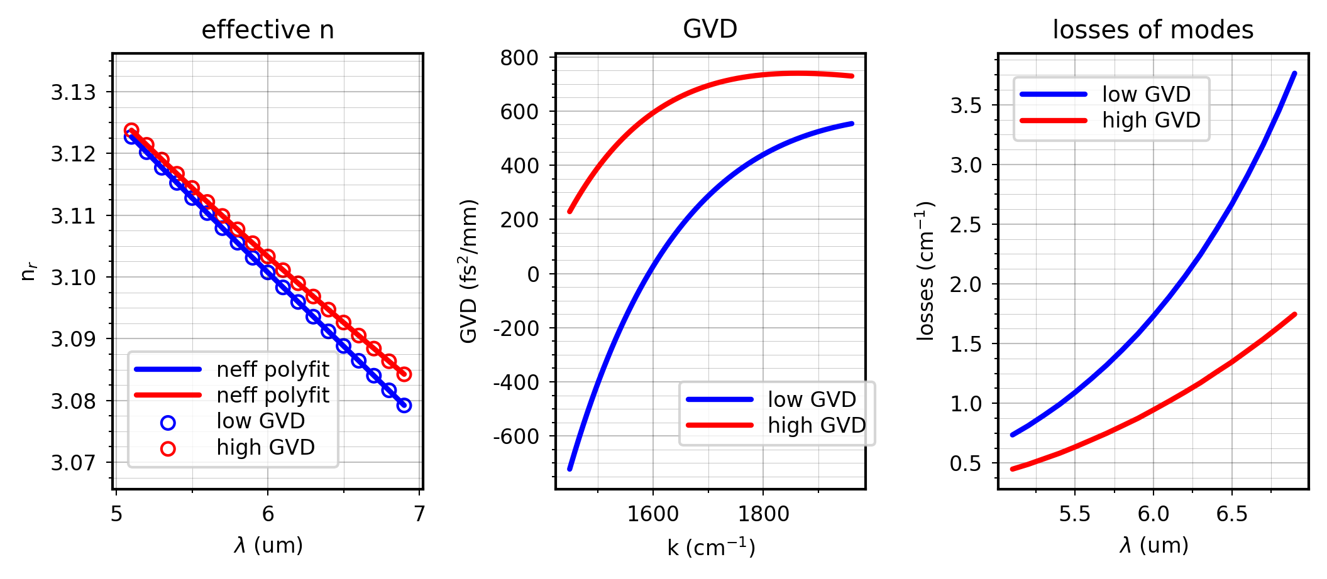
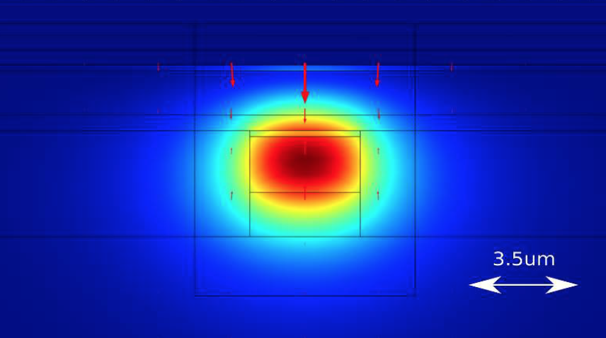
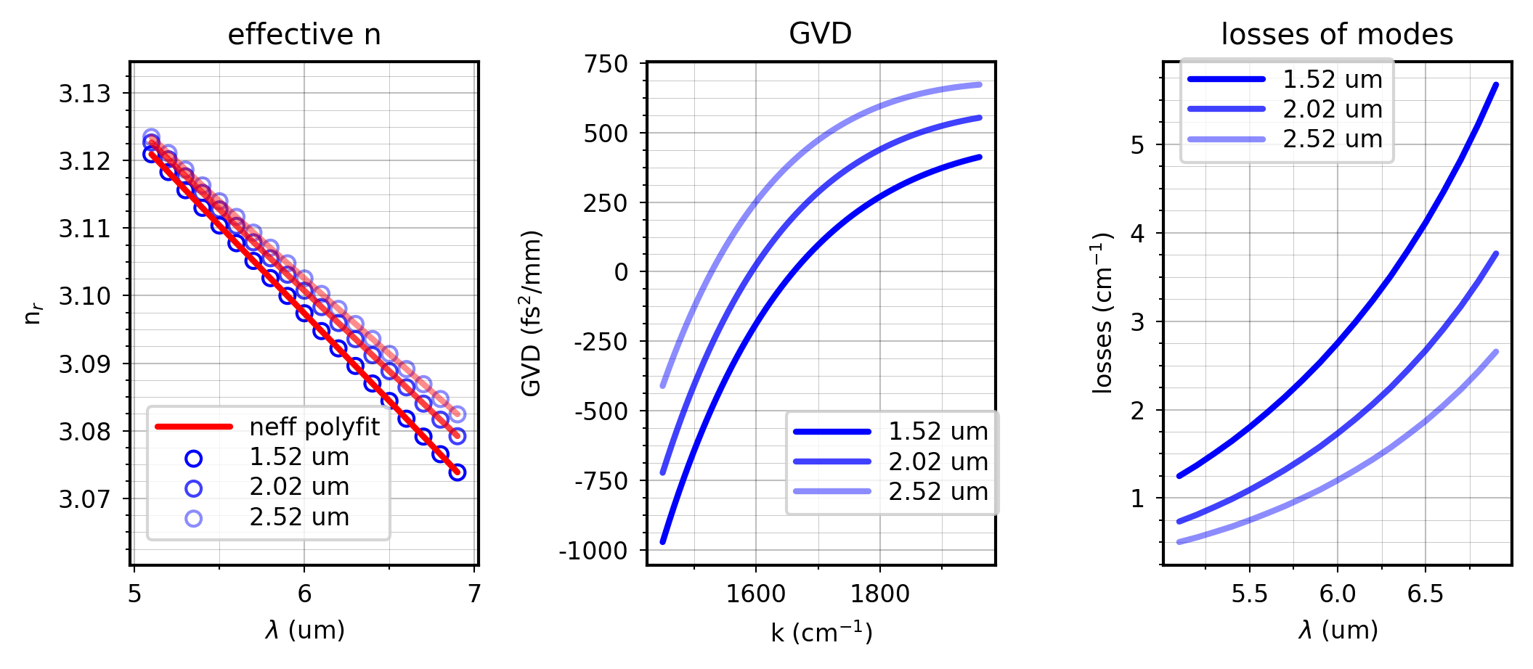

Task 3.2
  Dispersion control via top caldding (ALPES)
Highly doped cladding layer added
Wide tuning of GVD
Comparison with/without
optimized cladding
Comparing distance from active region
Hakobyan et al., “High performance quantum cascade laser frequency combs at λ ∼ 6 μm based on plasmon-enhanced dispersion compensation” (unpublished)

Slide 17
Task 3.2
Goals:
Baseline for QCL comb fabrication
Growth and fabrication of existing designs
Characterize and identify potentials for improvement
Delivered:
Identified several areas for fabrication improvement:
  Dry etching of laser ridges (ETH)
  Radio frequency injection efficiency (ETH)
  Optimizing ridge width (ETH + ALPES)
  Dispersion control via top caldding (ALPES)
ETH sent three 4.5 μm comb devices to CNR-INO
D3.3 completed on time (M9)

Slide 18
Tasks:
T3.1 M1-M3: Identification of existing QCL-comb devices (ETHZ)
T3.2 M3-M9: QCL-comb fabrication using existing technology and AR designs (ETHZ)
T3.3 M3-M9: Fabrication tolerances (ALPES)
T3.4 M9-M24: Fabrication and basic characterization of new comb devices (ETHZ)
T3.5 M25-M33: Further generation of devices (ETHZ)
T3.6 M24-M36: Mass production of improved devices (ALPES)
T3.7 M1-M24 : Fabrication of QCDs (CNRS + ETHZ)
Deliverables:
D3.1 M3
D3.3 M9
D3.4 M24
D3.5 M33
D3.6 M30
D3.2 M3
D3.7 M24
Milestones
MS3.1 M24 (ETHZ)
MS3.2 M27 (CNRS)

Slide 19
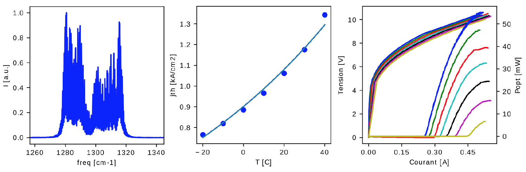
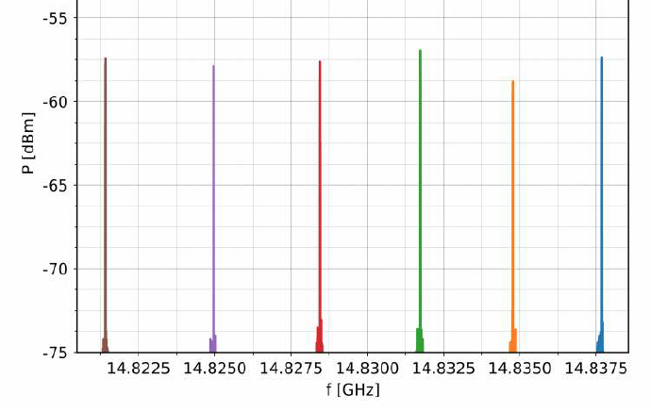
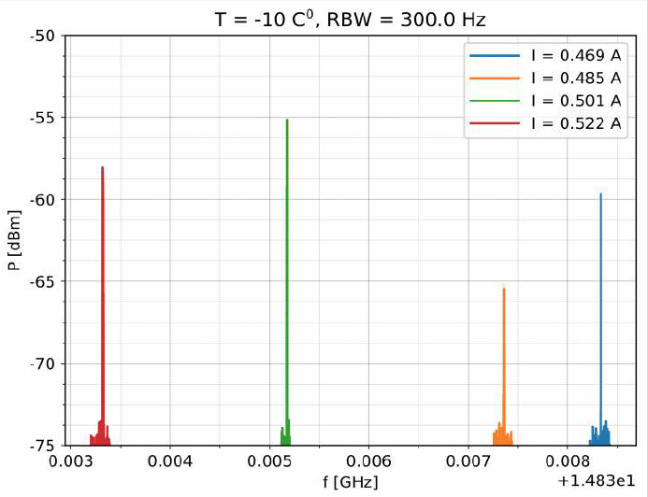
Task 3.3
ALPES
QCL-combs between 8-10 μm demonstrated by ALPES before Qombs
Using plasmon-enhanced waveguide for GVD compensation
Reproduced results with new growth and processing at 1290 cm⁻¹(λ=7.8 μm)
Very reproducible performance from laser to laser (λ=6 μm)
No limitations from fabrication tolerances: (λ=6 μm)
  Lasing from -10 °C to +50 °C realized for 2.8-5.5 μm waveguides, fab. tol. = ±0.5 μm
Laser 1 beatnote
Laser 2 beatnote
T = -10 °C

Slide 20
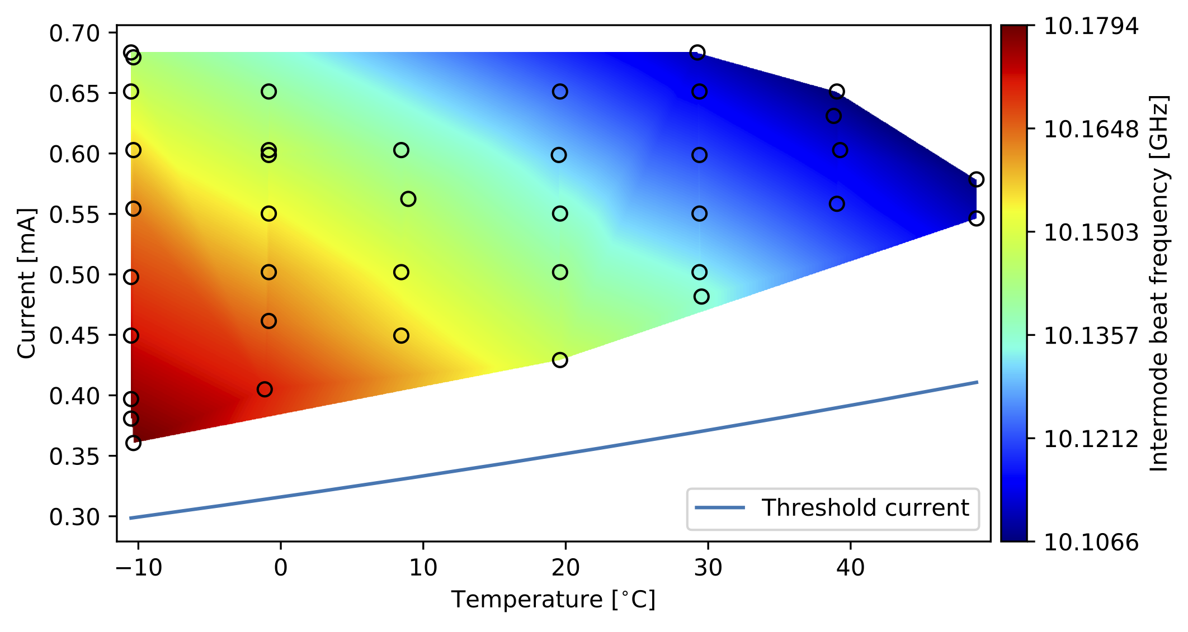
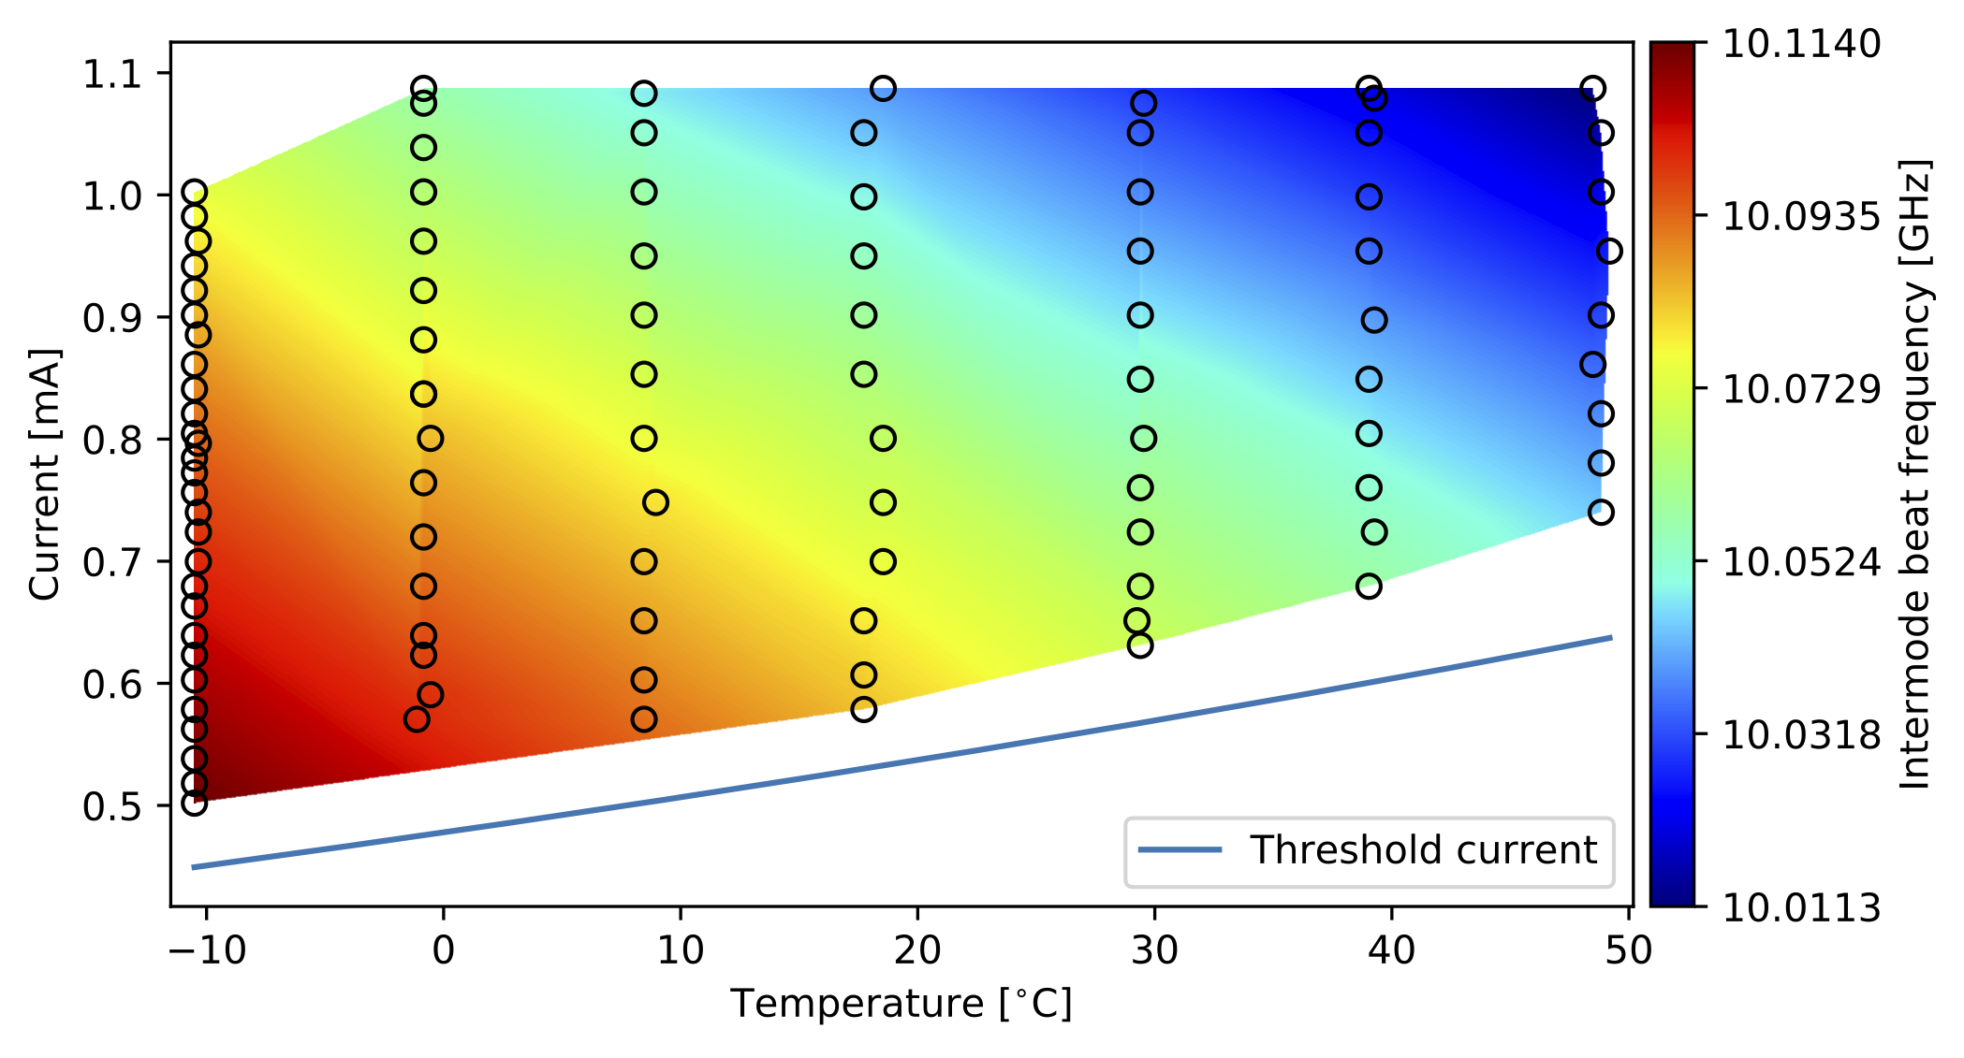
Task 3.3
ALPES
Production of QCL combs is more difficult at λ<8 µm because of higher material GVD
Previously demonstrated dual-waveguide design with passive InGaAs WG requires tight fabrication tolerances
New design with a thin, highly-doped plasmonic layer in the top cladding
No limitations from fabrication tolerances:
  Comb operation from -10 to +50 °C realized for w = 2.8-5.5 μm waveguides,
  Fabrication tolerance ∆w = ±0.5 μm
w = 2.8 µm
w = 5.5 µm
The colored area indicates the currents/temperatures at which comb operation was observed

Slide 21
Tasks:
T3.1 M1-M3: Identification of existing QCL-comb devices (ETHZ)
T3.2 M3-M9: QCL-comb fabrication using existing technology and AR designs (ETHZ)
T3.3 M3-M9: Fabrication tolerances (ALPES)
T3.4 M9-M24: Fabrication and basic characterization of new comb devices (ETHZ)
T3.5 M25-M33: Further generation of devices (ETHZ)
T3.6 M24-M36: Mass production of improved devices (ALPES)
T3.7 M1-M24 : Fabrication of QCDs (CNRS + ETHZ)
Deliverables:
D3.1 M3
D3.3 M9
D3.4 M24
D3.5 M33
D3.6 M30
D3.2 M3
D3.7 M24
Milestones
MS3.1 M24 (ETHZ)
MS3.2 M27 (CNRS)

Slide 22
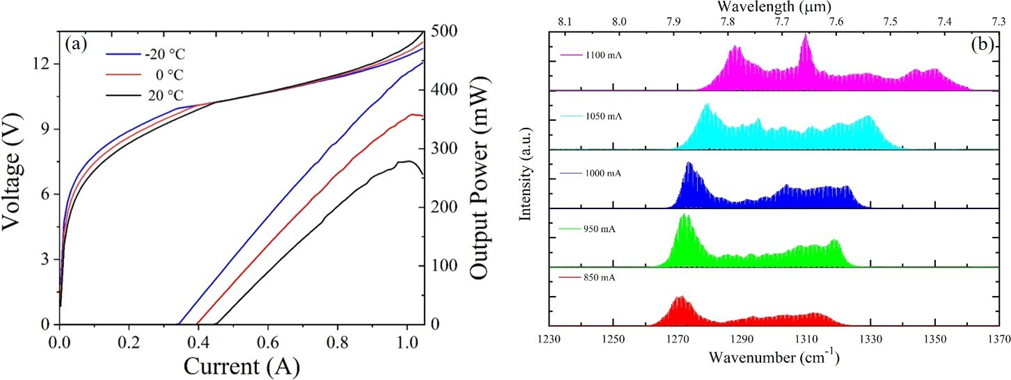
Task 3.4
Ongoing work (M9-M24)
(expecting delay due to MBE repair and lab lockdown due to COVID-19)
Optimized 5.5 μm wide waveguide (ETH)
Identified problem areas from Task 3.2
Laser ridge width
RF injection
  Spectrometer incorporated in setup
  Broadens spectrum
Dry etching
  Full active region height etching achieved
Growth and fabrication of designs from WP1
First fabrication of optimized active region done
Broad luminescence, no lasers yet
Giles-Turnois inteferometer (GTI) coatings
Dispersion compensation
Low-loss, high-reflectivity coatings
  Important for quantum optics (WP4)

Slide 23
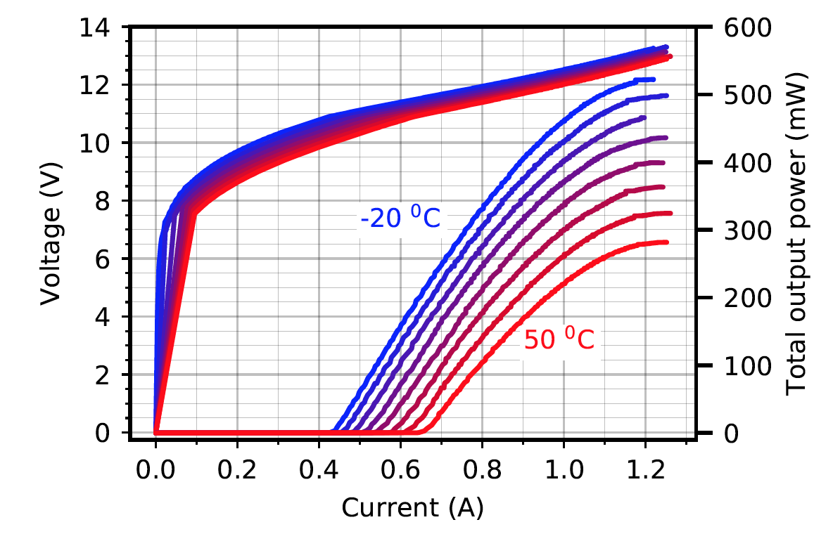
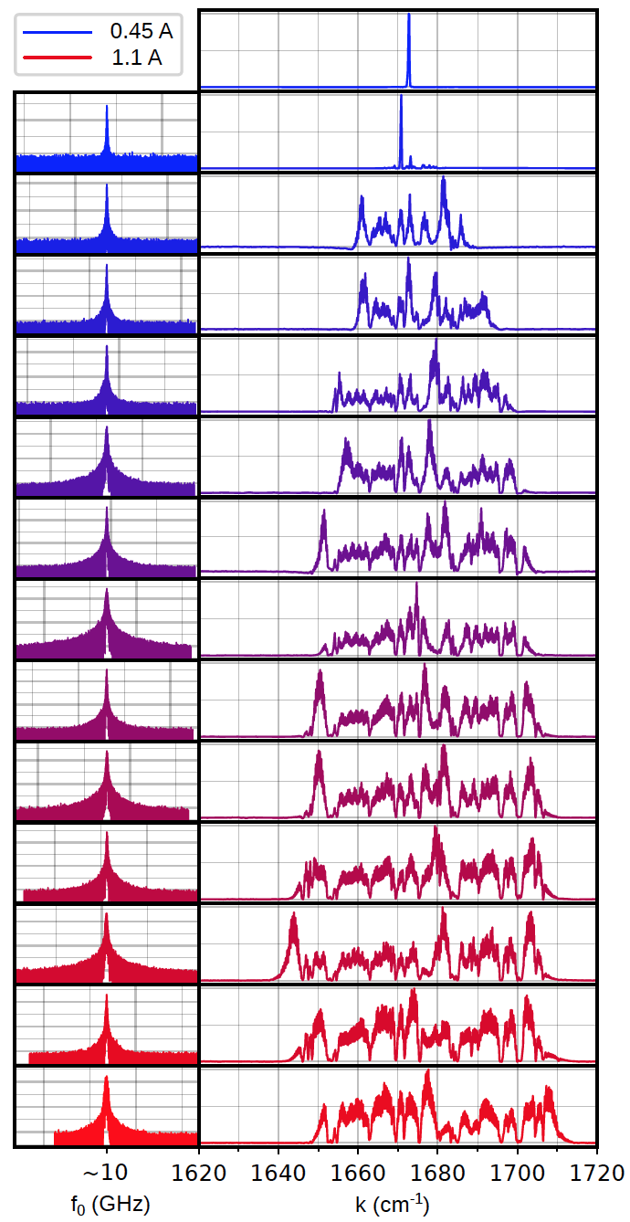
Task 3.4
Ongoing work (M9-M24)
(expecting delay due to MBE repair and lab lockdown due to COVID-19)
Optimized 5.5 μm wide waveguide (AL)
Identified problem areas from Task 3.2
Laser ridge width
RF injection
  Spectrometer incorporated in setup
  Broadens spectrum
Dry etching
  Full active region height etching achieved
Growth and fabrication of designs from WP1
First fabrication of optimized active region done
Broad luminescence, no lasers yet
Giles-Turnois inteferometer (GTI) coatings
Dispersion compensation
Low-loss, high-reflectivity coatings
  Important for quantum optics (WP4)

Slide 24
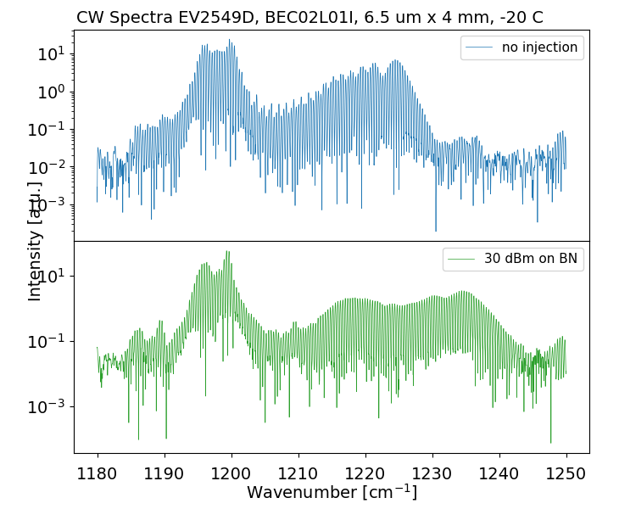
Task 3.4
Ongoing work (M9-M24)
(expecting delay due to MBE repair and lab lockdown due to COVID-19)
Identified problem areas from Task 3.2
Laser ridge width
RF injection
  Spectrometer incorporated in setup
  Broadens spectrum
Dry etching
  Full active region height etching achieved
40 cm⁻¹
Growth and fabrication of designs from WP1
First fabrication of optimized active region done
Broad luminescence, no lasers yet
55 cm⁻¹
Giles-Turnois inteferometer (GTI) coatings
Dispersion compensation
Low-loss, high-reflectivity coatings
  Important for quantum optics (WP4)

Slide 25
Task 3.4
Ongoing work (M9-M24)
(expecting delay due to MBE repair and lab lockdown due to COVID-19)
Identified problem areas from Task 3.2
Laser ridge width
RF injection
  Spectrometer incorporated in setup
  Broadens spectrum
Dry etching
  Full active region height etching achieved
3 μm
9 μm
Growth and fabrication of designs from WP1
First fabrication of optimized active region done
Broad luminescence, no lasers yet
Giles-Turnois inteferometer (GTI) coatings
Dispersion compensation
Low-loss, high-reflectivity coatings
  Important for quantum optics (WP4)

Slide 26
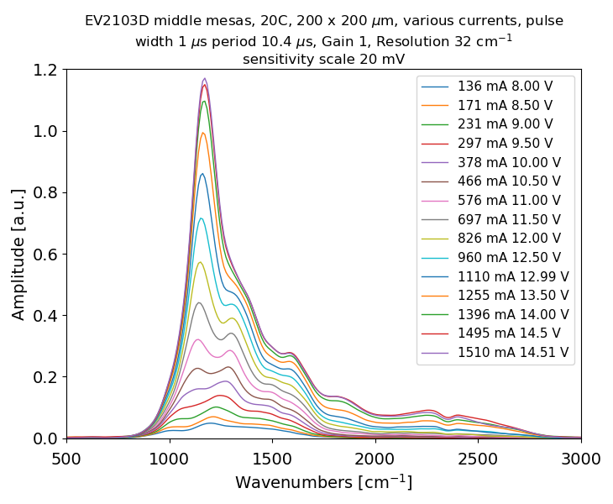
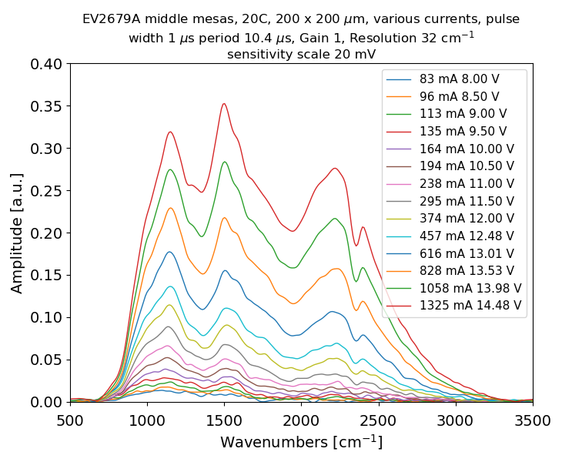
Task 3.4
Ongoing work (M9-M24)
(expecting delay due to MBE repair and lab lockdown due to COVID-19)
Identified problem areas from Task 3.2
Laser ridge width
RF injection
  Spectrometer incorporated in setup
  Broadens spectrum
Dry etching
  Full active region height etching achieved
Growth and fabrication of designs from WP1
First fabrication of optimized active region done
Broad luminescence, no lasers yet
Giles-Turnois inteferometer (GTI) coatings
Dispersion compensation
Low-loss, high-reflectivity coatings
  Important for quantum optics (WP4)

Slide 27
Task 3.4
Key achievements
QCL combs with 70 cm-1 comb spectra and 500 mW output power (AL)
λ = 6 μm
Improved fabrication

Slide 28
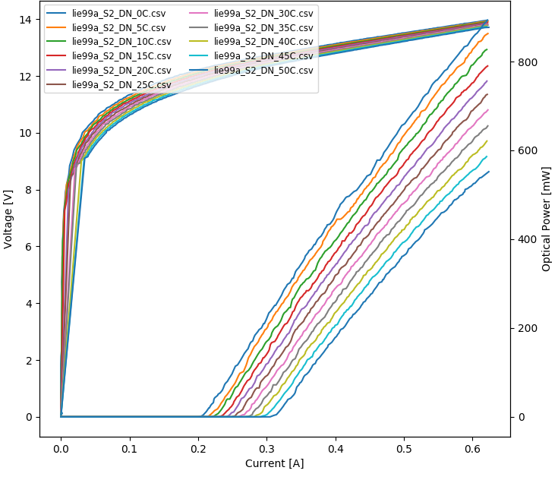
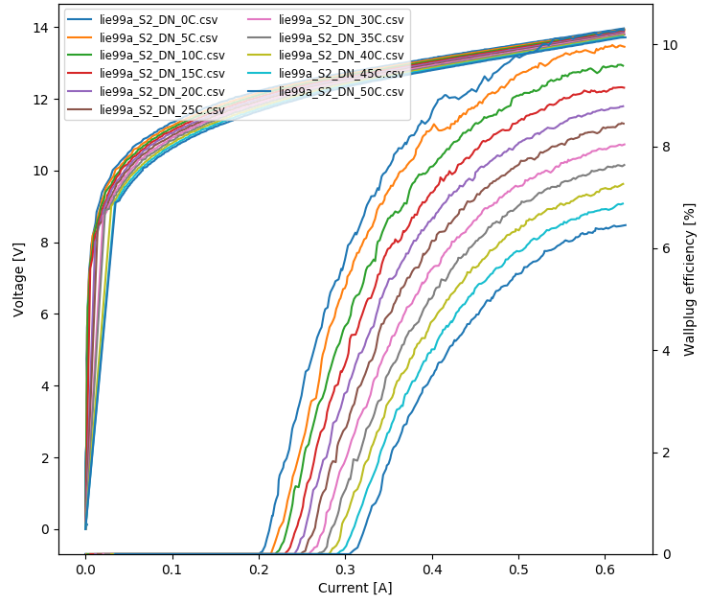
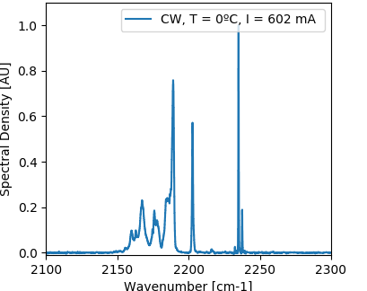
Task 3.4
Key achievements
QCL combs with 70 cm-1 comb spectra and 500 mW output power (AL)
Record low J_{th}(20°C) = 430 A/cm² for CW-QCL! (4.5 μm) (AL)
Not a comb yet
Next step:
Cancel GDD with
GTI facet coatings
HHL-755
W = 9.3 µm
L = 6 mm
Epi-side down
HR coated

Slide 29
Task 3.4
Key achievements
QCL combs with 70 cm-1 comb spectra and 500 mW output power (AL)
Record low J_{th}(20°C) = 430 A/cm² for CW-QCL! (4.5 μm) (AL)
First observation of increased comb bandwidth due to RF injection (ETH)
40 cm⁻¹
~35 dB
55 cm⁻¹

Slide 30
Task 3.4
Key achievements
QCL combs with 70 cm-1 comb spectra and 500 mW output power (AL)
Record low J_{th}(20°C) = 430 A/cm² for CW-QCL! (4.5 μm) (AL)
First observation of increased comb bandwidth due to RF injection (ETH)
40 cm⁻¹
55 cm⁻¹
Outlook
Fabricating improved comb devices at λ=4.5 μm
Growth of optimized active regions at 4.5 μm (from WP1)
Fabricate lasers from optimized λ=8 μm active region (from WP1)
Optimize re-growth for dry-etched waveguides

Slide 31
Tasks:
T3.1 M1-M3: Identification of existing QCL-comb devices (ETHZ)
T3.2 M3-M9: QCL-comb fabrication using existing technology and AR designs (ETHZ)
T3.3 M3-M9: Fabrication tolerances (ALPES)
T3.4 M9-M24: Fabrication and basic characterization of new comb devices (ETHZ)
T3.5 M25-M33: Further generation of devices (ETHZ)
T3.6 M24-M36: Mass production of improved devices (ALPES)
T3.7 M1-M24 : Fabrication of QCDs (CNRS + ETHZ)
Deliverables:
D3.1 M3
D3.3 M9
D3.4 M24
D3.5 M33
D3.6 M30
D3.2 M3
D3.7 M24
Milestones
MS3.1 M24 (ETHZ)
MS3.2 M27 (CNRS)

Slide 32
Tasks:
T3.1 M1-M3: Identification of existing QCL-comb devices (ETHZ)
T3.2 M3-M9: QCL-comb fabrication using existing technology and AR designs (ETHZ)
T3.3 M3-M9: Fabrication tolerances (ALPES)
T3.4 M9-M24: Fabrication and basic characterization of new comb devices (ETHZ)
T3.5 M25-M33: Further generation of devices (ETHZ)
T3.6 M24-M36: Mass production of improved devices (ALPES)
T3.7 M1-M24 : Fabrication of QCDs (CNRS + ETHZ)
Deliverables:
D3.1 M3
D3.3 M9
D3.4 M24
D3.5 M33
D3.6 M30
D3.2 M10
D3.7 M24
Milestones
MS3.1 M24 (ETHZ)
MS3.2 M27 (CNRS)

Slide 33
Task 3.7
Task 3.7 two parts:
Growth of detector epitaxial layers (ETH)
  Decision (CNRS+ETH) to focus on QCDs
  Designs proposed by CNRS grown (D3.2, M10)
Fabrication of detector devices (CNRS)
  Growths from D3.2 fabricated
  Absorption spectra agree with simulations
  Next generation of detectors required for better temperature performance
On-time delivery of D3.7 challenging due to MBE repairs and COVID-19 lockdown, but realistic

Slide 34
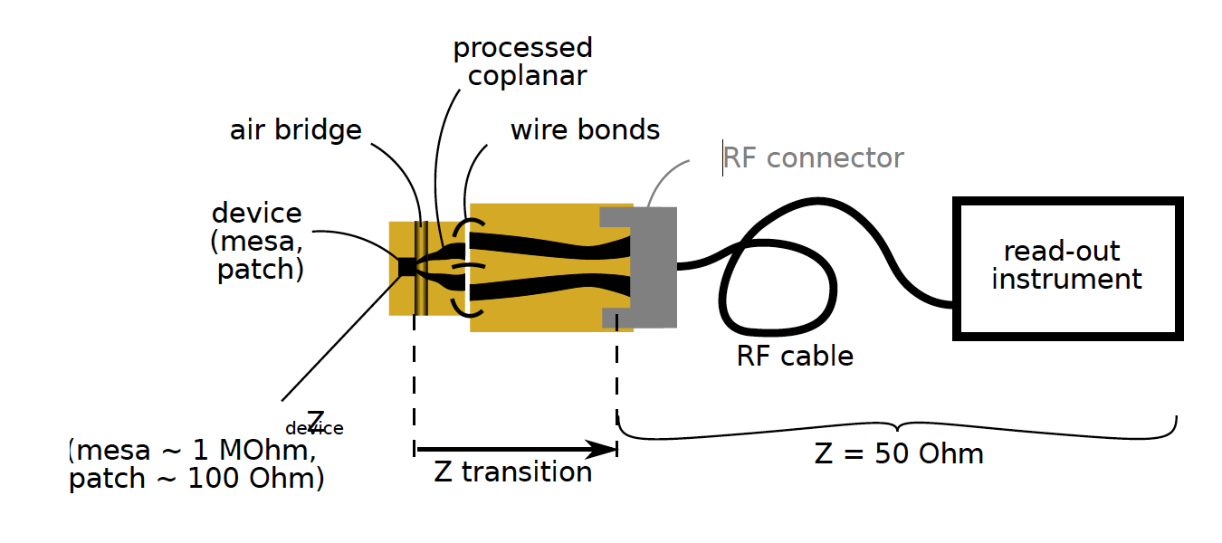
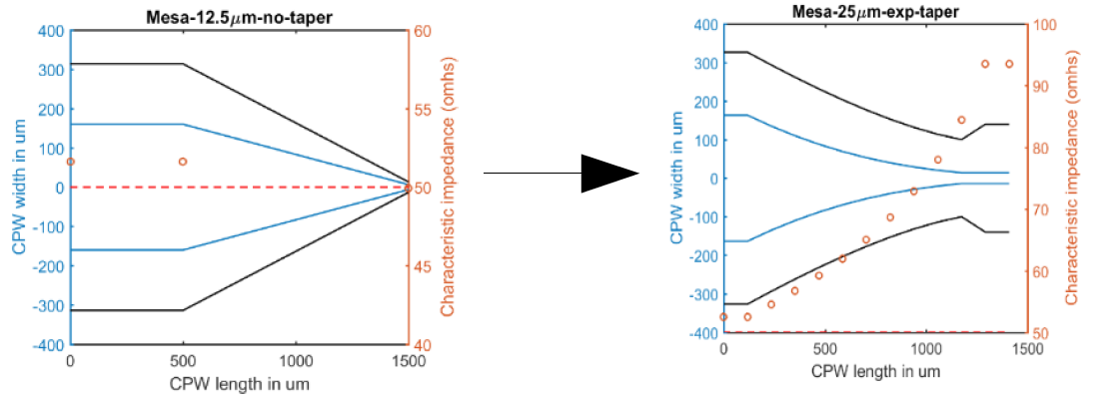
Task 3.7
Improvements to QCD fabrication (CNRS)
Goals:
High bandwidth (> 20 GHz)
Flat transmission
Challenge:
Impedance mis-match
Impedance matching
typically narrow band
Current solution:
Klopfenstein profiling*:
*R. Klopfenstein, “A transmission line taper of improved design”, Proc. IRE 44, pp. 31-35 (1956)

Slide 35
Summary
Tasks:
T3.1 M1-M3: Identification of existing QCL-comb devices (ETHZ)
T3.2 M3-M9: QCL-comb fabrication using existing technology and AR designs (ETHZ)
T3.3 M3-M9: Fabrication tolerances (ALPES)
T3.4 M9-M24: Fabrication and basic characterization of new comb devices (ETHZ)
T3.5 M25-M33: Further generation of devices (ETHZ)
T3.6 M24-M36: Mass production of improved devices (ALPES)
T3.7 M1-M24 : Fabrication of QCDs (CNRS + ETHZ)
Deliverables:
D3.1 M3
D3.3 M9
D3.4 M24
D3.5 M33
D3.6 M30
D3.2 M10
D3.7 M24
Milestones
MS3.1 M24 (ETHZ) “Improved QCL combs” (finalized with D3.4)
MS3.2 M27 (CNRS) “Improved QCDs or QWIPs” (finalized with D3.7)

Slide 36
Summary
Tasks:
T3.1 M1-M3: Identification of existing QCL-comb devices (ETHZ)
T3.2 M3-M9: QCL-comb fabrication using existing technology and AR designs (ETHZ)
T3.3 M3-M9: Fabrication tolerances (ALPES)
T3.4 M9-M24: Fabrication and basic characterization of new comb devices (ETHZ)
T3.5 M25-M33: Further generation of devices (ETHZ)
T3.6 M24-M36: Mass production of improved devices (ALPES)
T3.7 M1-M24 : Fabrication of QCDs (CNRS + ETHZ)
Deliverables:
D3.1 M3
D3.3 M9
D3.4 M24
D3.5 M33
D3.6 M30
D3.2 M10
D3.7 M24
Milestones
MS3.1 M24 (ETHZ) “Improved QCL combs” (finalized with D3.4)
MS3.2 M27 (CNRS) “Improved QCDs or QWIPs” (finalized with D3.7)
Thank you for your attention

Slide 37
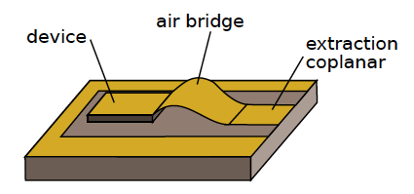
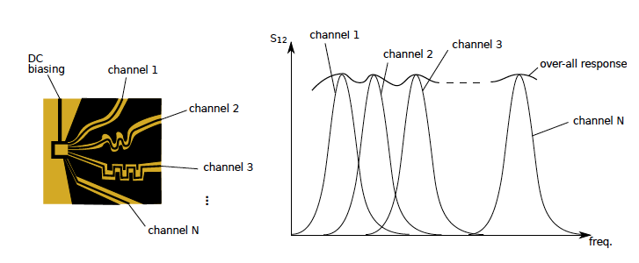
Task 3.7
Improvements to QCD fabrication (CNRS)
Goals:
High bandwidth (> 20 GHz)
Flat transmission
Challenge:
Impedance mis-match
Impedance matching
typically narrow band
Possible solutions:
Klopfenstein profiling*:
Air bridge:
Resonant co-planar waveguides:
*R. Klopfenstein, “A transmission line taper of improved design”, Proc. IRE 44, pp. 31-35 (1956)

Slide 38
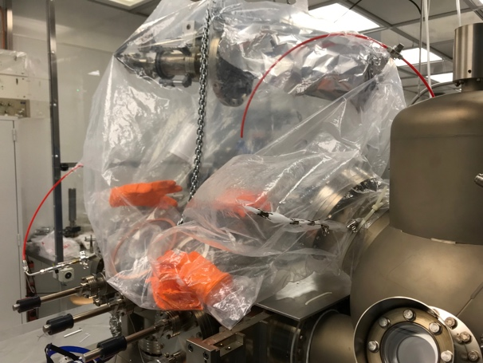
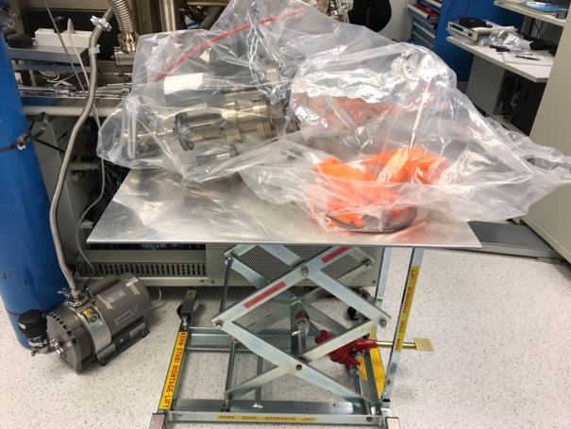
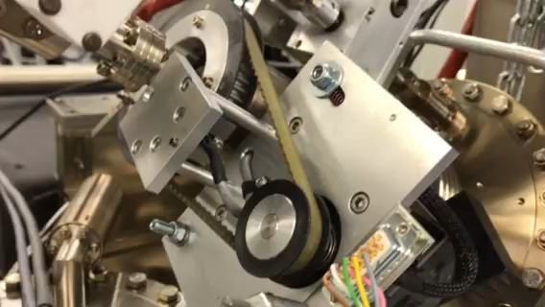
MBE breakdown
M2
Nov 2, 2018: Growth of record temperature THz QCL
Nov 26, 2018: Al cell failed
Dec 2018: MBE opened for repair
D3.2 planned
Feb 2019: MBE operational again
  MBE in good condition
  Low background doping
Mar 2019: wafer rotation failed
  MBE opened under Argon purge
  Wafer manipulator extracted inside glove bag
  2/3 bearings broken
April 2019: New bearings delivered
May 2019: System under vacuum
June 2019: Calibrations, MBE operational
July 2019: wafer rotation failed
  Growth of layers for D3.2 (delayed to M10)
Aug 2019: further short growth sessions with
unstable rotation
M3
M5
M6
M7
M8
M9
M10
M11

Slide 39
MBE breakdown
M2
Nov 2, 2018: Growth of record temperature THz QCL
Nov 26, 2018: Al cell failed
Dec 2018: MBE opened for repair
D3.2 planned
Feb 2019: MBE operational again
  MBE in good condition
  Low background doping
Mar 2019: wafer rotation failed
  MBE opened under Argon purge
  Wafer manipulator extracted inside glove bag
  2/3 bearings broken
April 2019: New bearings delivered
May 2019: System under vacuum
June 2019: Calibrations, MBE operational
July 2019: wafer rotation failed
  Growth of layers for D3.2 (delayed to M10)
Aug 2019: further short growth sessions with
unstable rotation
M12
Sept 2019: Preparing for opening
  Argon purge to minimize moisture
  Glove box
  Removed entire manipulator
  Ordering of rare parts
Oct 2019: Opening, repairs done
Nov 2019: Closing, baking, recovering vacuum
Jan-Feb 2020: Calibrations, heating cells
Mar 2020: COVID-19 lockdown of ETH
M3
M5
M13
M14
M6
M16
M18
M7
M8
M9
M10
M11

Slide 40
MBE breakdown
M2
Nov 2, 2018: Growth of record temperature THz QCL
Nov 26, 2018: Al cell failed
Dec 2018: MBE opened for repair
D3.2 planned
Feb 2019: MBE operational again
  MBE in good condition
  Low background doping
Mar 2019: wafer rotation failed
  MBE opened under Argon purge
  Wafer manipulator extracted inside glove bag
  2/3 bearings broken
April 2019: New bearings delivered
May 2019: System under vacuum
June 2019: Calibrations, MBE operational
July 2019: wafer rotation failed
  Growth of layers for D3.2 (delayed to M10)
Aug 2019: further short growth sessions with
unstable rotation
M12
Sept 2019: Preparing for opening
  Argon purge to minimize moisture
  Glove box
  Removed entire manipulator
  Ordering of rare parts
Oct 2019: Opening, repairs done
Nov 2019: Closing, baking, recovering vacuum
Jan-Feb 2020: Calibrations, heating cells
Mar 2020: COVID-19 lockdown of ETH
M3
M5
M13
M14
M6
M16
M18
M7
M8
Current status (M20)
May 5, 2020: First growth
May 11-22: Growth of GaAs to purify system,
callibrate doping
May 25-Jun 5: Melt Al cell, de-gas and grow
AlAs to purify further
Jun 8: Resuming growth of QCLs and QCDs
(M21)
M9
M10
M11

Slide 41
Implications for the Project
Task | Deliverable | Risk | Reason and mitigation
T3.4 (M9-24) | D3.4 (M24) | Low | MBE expected online June 2020. Little time for growth of new QCLs. Worst case: growth by Alpes.
T3.5 (M24-33) | D3.5 (M33) | Very low | Still plenty of time for growth of final QCL devices.
T3.7 (M1-24) | D3.7 (M24) | Very low | If grown detectors do not work, second growth is necessary. D3.7 delayed iff QCDs and MBE fails.
T1.5 (M1-24) | D1.3 (M24) | No risk | Input from D3.4 useful for further optimization. If no input is received or delayed, T1.2-T1.4 is enough.
T4.1.2 (M6-M36) | D4.3 (M24) | Very low | Iff D3.4 is significantly delayed will this be affected.
T4.4.2 (M7-24) | D4.3 (M24) | Very low | Same as above
T4.3 (M12-36) | D4.4 (M30) | Very low | Iff D3.7 is significantly delayed will this be affected.

Slide 42
Dissemination
Publications
Conference contributions
Hakobyan et al., “High performance quantum cascade laser frequency combs at λ ∼ 6 μm based on plasmon-enhanced dispersion compensation”
Optics Express (2020)
Biglioni et al., “Mixing properties of room temperature patch-antenna receivers in a mid-infrared (λ~9 μm) heterodyne system”
Laser & Photonics Reviews 14, 1900207 (2020)
S. Hakobyan et al., CLEO 2020, Online, 11.-15.5.2020
S. Hakobyan et al., SPIE DCS, Online, 27.4.-8.5.2020
M. Franckie et al., CLEO Europe, Munich, 23.-26.7.2019
M. Franckie et al., EDISON 21, Nara, Japan, 14.-19-7-2019
M. Franckie et al., SPS Annual Meeting, Zurich, 26.-30.8-2019
M. Franckie et al., ITMMW-THz, Paris. 1.-6.9.2019
M. Franckie et al., ITQW, Ojai, CA, USA, 15.-20.9.2019
J. Enkner et al., Summer School, Vienna, 16.-20-9-2019
B. Schneider et al., Optical Sensing Autumn School 19, Tromsö,Finland, 27.10.-1.11.2019

Slide 43
Conference contributions
EDISON 21, Nara: New Frontiers for THz Quantum Cascade Lasers:
NEGF Optimization and Fabrication of Devices Operating Above 205 K
M. Franckie, L. Bosco, M. Beck, and J. Faist
ITQW, Ojai Valley, USA 2019: Two-Quantum Well THz Quantum Cascade Lasers Operating Up To 210 K
M. Franckié, L. Bosco, M. Beck, E. Mavrona, A. Wacker, J. Faist
CLEO Europe, Munich 2019: Optimization and fabrication of two-quantum well THz QCLs operating above 200 K
M. Franckie, L. Bosco, M. Beck, E. Mavrona, A. Wacker, G. Scalari, J. Faist
SPS annual meeting, Zürich 2019: Thermoelectrically cooled THz Quantum Cascade Lasers operating up to 210 K.
L. Bosco, M. Franckie, M. Beck, G. Scalar, A. Wacker, J. Faist
IRMMW-THz, Paris 2019: THz Quantum Cascade Lasers Operating up to 210 K
M. Franckié, L. Bosco, E. Mavrona, A. Wacker, and J. Faist
Optical Sensing Autumn School 19, Tromsö: RF Study of Quantum Cascade Laser Optical Frequency Combs
B. Schneider, F. Kapsalidis, M. Singleton, M. Beck and J. Faist
SPIE DCS, Online 2020: High performance QCL frequency comb at 6 µm.
Sargis Hakobyan, Richard Maulini, Stéphane Blaser, Tobias Gresch, and Antoine Muller
CLEO 2020, Online 2020: High performance quantum cascade laser frequency combs at ~6 μm
S. Hakobyan, R. Maulini, S. Blaser, T. Gresch, Y. Francescato, A. Muller, P. Allmendinger, M. Mangold, P. Jouy, and A. Hugi

Slide 44

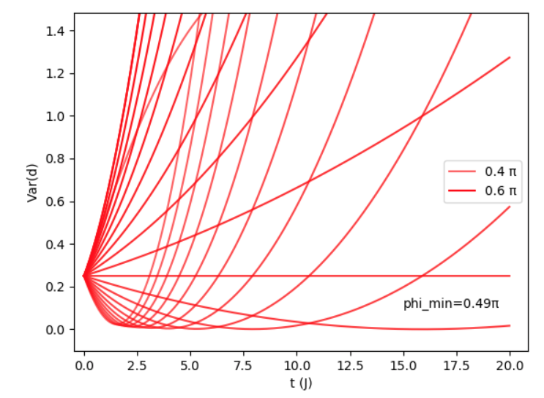
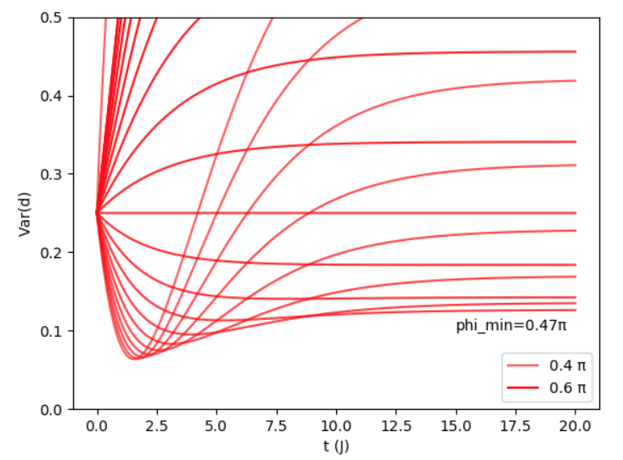
Simulation of QCL squeezing
Preliminary results
Three-mode QCL, strong pump treated classically (coherent state)
Effective Hamiltonian of the system:
Solving Heisenberg – Langevin equations of motion for
quadrature d(φ)
χ⁽³⁾
Lasing mode
Gain
a
b
Params: no loss, no gain
Params: loss=0.2 J, no gain

Slide 45
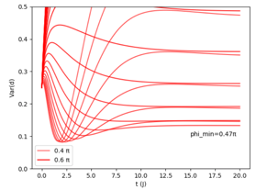
Simulation of QCL squeezing
Preliminary results
Three-mode QCL, strong pump treated classically (coherent state)
Effective Hamiltonian of the system:
Solving Heisenberg – Langevin equations of motion for
quadrature d(φ)
χ⁽³⁾
Lasing mode
Gain
a
b
Params: no loss, no gain
Params: loss=0.2 J, g(t=0) =0.7J

Slide 46
Simulation of QCL squeezing
Preliminary results
Three-mode QCL, strong pump treated classically (coherent state)
Effective Hamiltonian of the system:
Solving Heisenberg – Langevin equations of motion for
quadrature d(φ)
χ⁽³⁾
Lasing mode
Gain
a
b
Under circumstances with large J compared to gain,
squeezing achievable
Params: no loss, no gain
Params: loss=0.2 J, g(t=0) =0.7J

