Slide 1
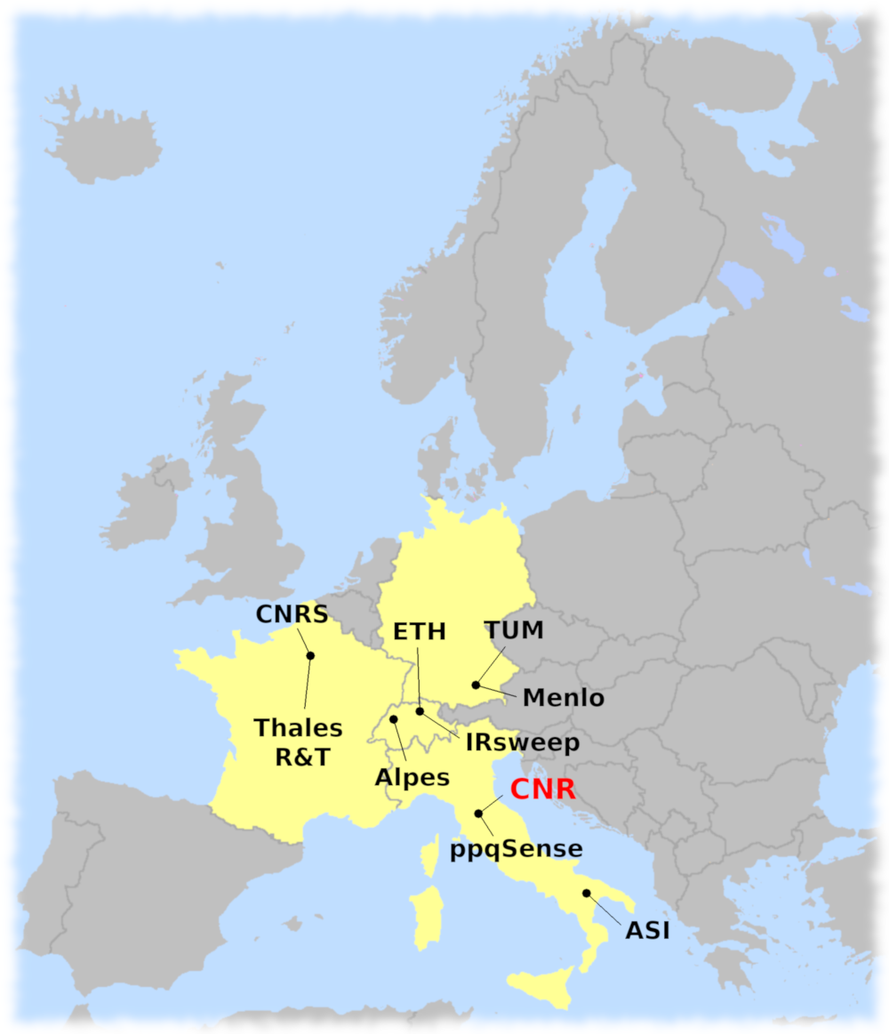
Introduction
Consortium
Universities and Research Institutes:
Coordinator: Consiglio Nazionale delle Ricerche (CNR – Italy)
Eidgenössische Technische Hochschule Zürich (ETH – Switzerland)
Technische Universität München (TUM – Germany)
Centre National de la Recherche Scientifique (CNRS – France )
Agenzia Spaziale Italiana (ASI – Italy)
Companies:
Alpes Lasers (Switzerland)
IRsweep (Switzerland)
ppqSense (Italy)
Menlo Systems (Germany)
Thales Research & Technology (France)
Augusto Smerzi (coordinator)
Francesco Cappelli (project manager)
Mid-Term Review Meeting
May 13, 2020

Slide 2
Introduction
Agenda of the meeting
09:00 Project introduction, progress, main results – Augusto Smerzi (Coordinator)
09:10 Dissemination activity and collaborations (WP6) – Francesco Cappelli (Project Manager)
09:20 Financial overview – Donata Fornaciari (Administrative Manager)
Technical presentations of work packages activities and results
09:25 WP1 "Modeling, numerical simulation and witnesses of squeezing and entanglement" – Christian Jirauschek
09:55 WP2 "Quantum simulation with ultracold atoms" – Giacomo Roati, Francesco Minardi
10:35 WP3 "Fabrication" – Martin Franckié
11:05 break
11:15 WP4 "Characterization" – Natalia Bruno, Alessandro Zavatta
11:50 WP5 "Industrialization and applications", companies innovations – Richard Maulini
12:00 Discussion
01:00 end
2

Slide 3
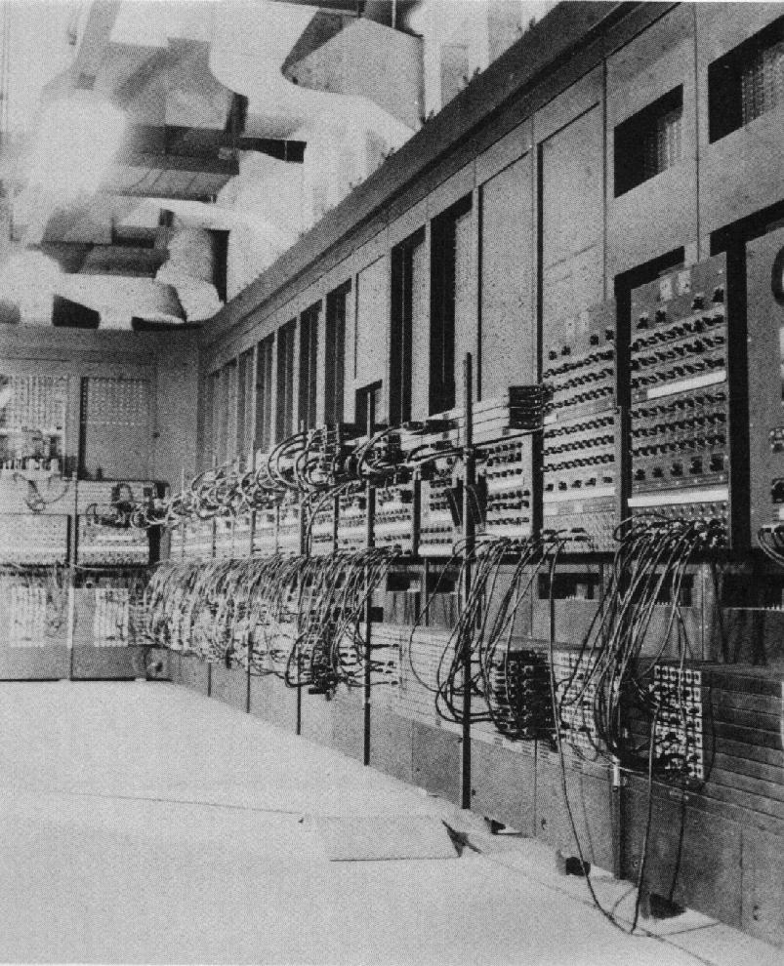
Introduction
Quantum systems do not live in our
physical space but in a huge (Hilbert) space
Why quantum simulation?
Quantum Mechanical systems cannot
be studied with classical computers.
The storing memory and number of operations grow exponentially with the size of the quantum system.
Even big computers
cannot be big enough
ENIAC
(1946)
3

Slide 4
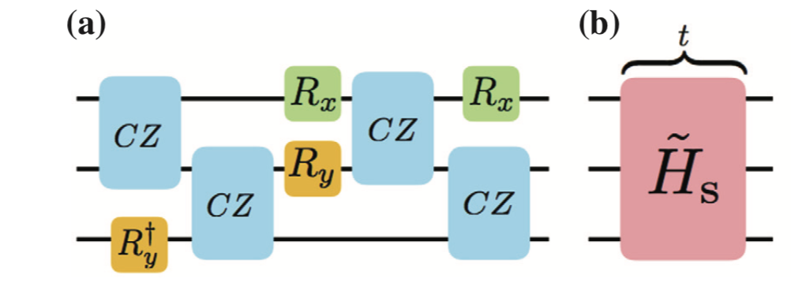
Introduction
IDEA: “Let the computer itself be built of
quantum mechanical elements which obey
quantum mechanical laws.” (RPF, ‘82)
Quantum simulators
tailor controllable quantum systems to
simulate other complex quantum systems.
Digital simulator: decompose the evolution of the Hamiltonian in terms of of single- and two-qubit gates. Advantages: Flexible, allows in principle for quantum error correction and universality.
Our atomic simulator:
Analog simulator: task-oriented, the Hamiltonian is a model of the simulated system. High scalability and robustness: implementation on large quantum systems (~10^5 particles…). Global control over many lattice sites or coupled quantum systems.
Disadvantage: not known error-correction protocols.
Interaction control (Feshbach resonances)
High-resolution detection (in-situ and momentum space)
Programmable (holographic) arbitrary optical potentials
Our quantum simulation task: Simulate a quantum cascade laser frequency comb.
4

Slide 5
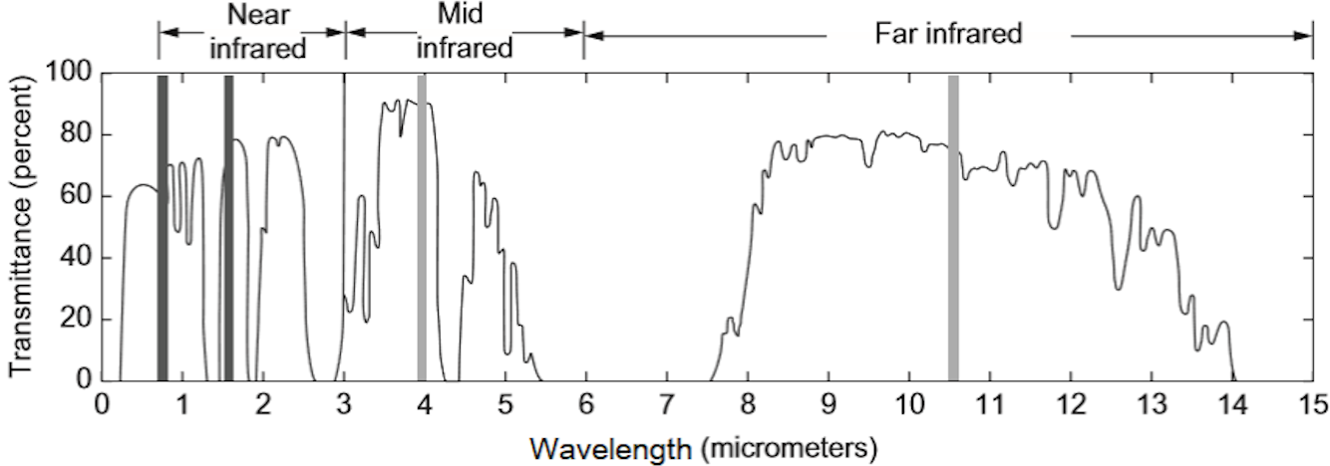
Introduction
Goal of the Qombs Project:
develop a compact source of multifrequency non-classical light in the infrared
Why? Next generation devices in communications and sensing.
Free-space communications
Radiation confined in beams reasonably collimated and sized
atmospheric transparency windows
well-reduced Rayleigh scattering
decreased effect of scintillation
strongly-reduced interference of the sunlight.
Infrared:
molecular fingerprint region (fundamental ro-vibrational molecular transitions)
quantum-enhanced sensing for environmental and health monitoring.
5

Slide 6
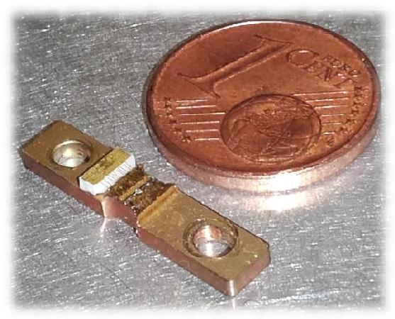
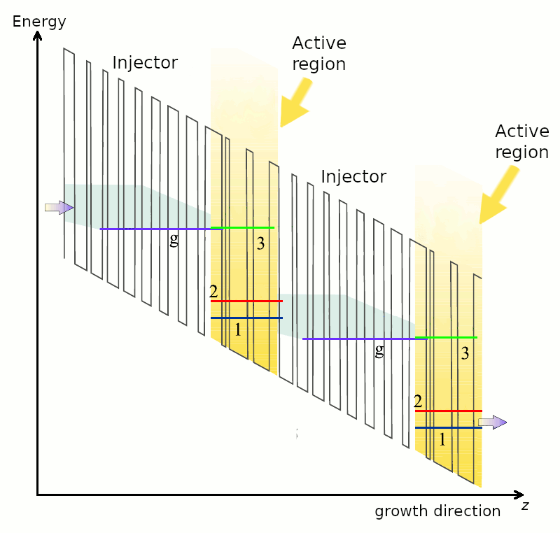
Introduction
Qombs Project - the quantum cascade laser (QCL):
current-driven source able to emit single-frequency or frequency comb (QCL-comb) infrared radiation
up to now only classical light
Active region:
semiconductor heterostructure
superlattice of semiconductor layers with nanometric thickness (quantum wells)
giant third-order nonlinearity → FWM
6

Slide 7
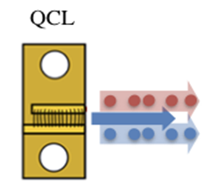
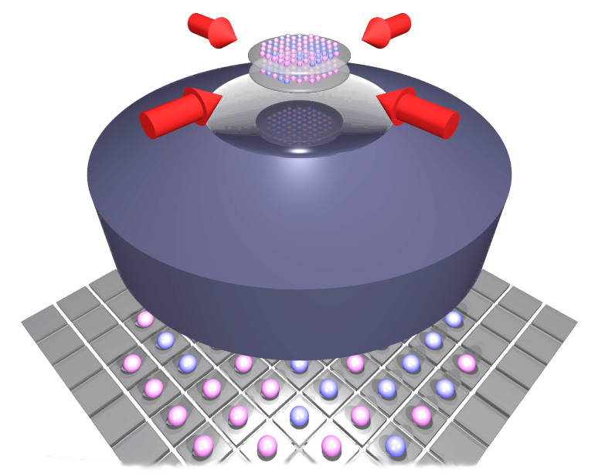
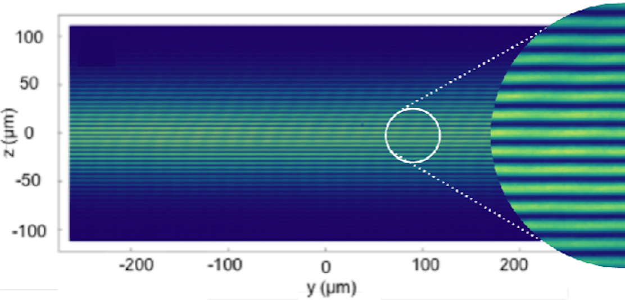
Introduction
Quantum simulation: design and optimizing QCLs able to provide frequency combs where each optical mode is squeezed, with additional entanglement among the different frequency modes.
Strategy:
Developing an analog quantum simulator using as platform a trapped ultracold atomic gas.
gain a detailed understanding of the many-body processes involved in the formation of non-classical frequency combs
carrier transport (Fermi gas in optical lattice)
frequency comb formation, nonlinear interaction between photons (Bose gas)
7

Slide 8
Deliverables & milestones
At the moment we have successfully submitted all the expected 17 deliverables and 1 milestone:
D1.1 First improved QCL-comb design - 31 Mar 2019
D1.2 Improved QCD and QWIP detector designs - 30 Sep 2019
D1.6 Coefficient to quantify number squeezing in multi-mode systems - 30 Sep 2019
D1.7 Criterion for the identification of multi-mode entanglement in QCLs - 31 Mar 2020
D2.1 Fermi gas in 1D optical lattice - 30 Sep 2019
D2.2 Raman-assisted tunneling - 31 Mar 2020
D2.3 Kapitza-Dirac atomic interferometer - 31 Mar 2020
D3.1 Selected existing QCL-comb devices - 31 Dec 2018
D3.2 Detector epitaxial layers - 30 Apr 2019
D3.3 QCL-combs fabricated with current technology - 30 Jun 2019
D4.1 First QCL-comb devices characterized and delivered to TRT and IRS - 31 Jul 2019
D4.2 Metrological DFG mid-infrared comb prototype delivered to CNR - 31 May 2019
D4.3 New-generation QCL-combs (first improved design - D1.1) characterized and delivered to TRT and IRS - 30 Sep 2019
D4.8 Commercial ultra-low noise current drivers fabricated and delivered to partners - 31 Mar 2019
D4.10 Report on the limiting factors of current dual-comb systems and expected improvement by the developed devices - 31 Mar 2019
D6.1 Project Website - 28 Feb 2019
D6.2 Draft version of the PEDR - 30 Sep 2019
MS1 First improved QCL-comb active region design - WP1 - Achieved on March 28, 2019
8

Slide 9
Performed work and main results
WP1 – Design:
New QCL active regions for improved frequency comb operation have been designed and optimized. They have the potentiality of exhibiting enhanced nonclassical features in the emission.
WP2 – Fermionic analog simulator:
A large spacing 1D optical lattice to mimic the multi-well configuration of QCL heterostructures has been realized.
The behavior/dynamics of the Fermi gas in a single 2D layer is under characterization.
WP2 – Bosonic analog simulator:
An interferometric protocol producing, separating and recombining multiple copies of a single Bose-Einstein condensate has been developed. A multimode Kapitza-Dirac beam-splitter has been realized.
To reduce the amplitude of oscillations in the trap we decided to shift to a "Bragg interferometer", where only two momentum components are present. We found that interatomic interactions affect the fringe wave vectors k, both for the free-space and the in-trap Bragg interferometers. Understanding the role of such interactions has a key role for the project.
WP3 – QCL devices Fabrication:
Several QCL devices have been fabricated employing current technology and distributed among the project partners for characterization.
Optimized procedures for fabrication have been tested and used for fabricating new devices based on the design developed within the project.
A new waveguide type, including a plasmonic layer in the top cladding, has been developed and realized. The first characterization results look promising.
9

Slide 10
Performed work and main results
WP4 – Characterization of new QCL devices:
The classical characterization of several QCL devices has been performed (frequency/intensity noise), showing good results in terms of spectral coverage, frequency and amplitude noise. The parameter will be used as benchmarks for future characterizations of optimized devices.
The quest for nonclassical features (squeezing) in the new QCLs emission started. The search for nonclassical features in QCL-combs emission is ongoing, results are expected in the second project period.
The new devices have been tested for applications such as dual-comb spectrometers.
WP6 – Dissemination:
In total, 11 peer-reviewed papers regarding the results obtained within the project have been published (or are in press) in high-impact international journals.
Several people involved in the project participated to numerous international conferences disseminating the obtained results.
The organization of an international conference on QCLs is ongoing (IQCLSW 2020).
10

